Slide 1
Surveillance Technology Working Group
Meeting #27 6.07.2022

Slide 2
Agenda
Discussion of new Technology Request for Review - Dataminr
Coming Up
Questions

Slide 3
Review
Past Decisions
Fotokite: Aerial UAS allowing for different perspectives during crisis response. Not exempt, will go through the process.
Press Release out, done with public comment period
Public comments received, received comments from SPD
Recommendation was sent to the Mayor
Vacant Lot Monitoring: Sensor that detect changes in a scene to monitor lots for dumping. Not exempt, will go through the process.
Press Release out, done with public comment period
Public comments received, waiting for updated data from the requesting department
Community Asset Tracker: Camera with machine learning algorithm to identify objects within the city.
Assessed pilot, documentation provided
COPS: Cameras strategically placed around the city to aid in policing
Exempted

Slide 4
Review
Past Decisions
Samsara: Fleet management technology
Assessed in previous session
Public comment period completed
Recommendation was sent to the Mayor on 2/01
Mayor Walsh stated that he read the read the groups recommendations, and is in agreement with a qualified approval, and is in agreement with the importance of putting in appropriate policies and procedures.
Flock Safety/ALPRs: Street cameras that capture vehicle plates.
Assessed in previous session
Public comment period completed
The Work Group heard from SPD Officers on 1/25/22 for more information regarding this.
The STWG created guidelines for ALPR Use and this was recommended to the mayor with the stipulations written on 3/11/22.

Slide 5
Review
Past Decisions
Cyclomedia: Right of Way Imaging
Public comment period completed
Recommendation was sent to the Mayor on 5/07/22
Mayor Walsh stated: I have reviewed the STWG’s recommendation and I am in agreement with it.

Slide 6
Review
Internal Norms
Attendance:
If members have unjustified absences for three meetings in a three month time period, the Surveillance Team Working Group (STWG) Coordinators will reach out to the member.
The working group is required to have at least 50% of all members present before we hold a recommendation vote.
Of those present at least 40% should be non-city staff.
External Participants:
Outside participants should request permission before-hand to the API team.
The API team will inform the STWG before meetings if there will be outside participants joining the group.
Documentation for Community Review:
The notes from the STWG Sessions will be posted to the STWG Website after the meetings.
Letter of Commitment:
Is effective for one year, and is to be sent out annually.
View Attendance and Guest Norms

Slide 7
Review
Service Level Agreements (SLAs)
2 - 6 Weeks
(10 - 30
Business Days)
Every 2 Weeks
(10 Business Days)
2 Weeks
(10 Business Days)
2 Weeks
(10 Business Days)
Initial submission to determination of surveillance
Short duration meeting to vote on technology exemptions
Public comment period:
Issuance of press release
Council meeting
(*) For now public input will be received via a Google Form and in the future will be on the new website.
Submission of finalized form (by dept.) to time of recommendation.
Group will individually research; departments will get follow-up questions; group to vote yes/no; and submit recommendation.

Slide 8
STWG Long Term Plan (Review)
Update STWG Website
Tech Recommendations
Meeting Notes and Slide Decks
Connect with other cities doing surv. tech work
Revamp our approach to community engagement
Complete Citywide departmental training
Determine Schedule for refresher trainings (annually or every 6 months)
Complete an audit of technologies currently used by the City as Surveillance or Not
Release an Annual Report
Including recommendations, data that came from recommendations, and if stipulations are being followed.
Short Term
(April - June)
Medium Term
(July - September)
Long term
(October - December)

Slide 9
STWG Long Term Plan (Review)
Begin process of trying to transfer STWG to a City Ordinance
Determine Member’s Term Duration
Requires more planning

Slide 10
Membership Commitment Letter
Letter of Commitment:
We are still missing 3 Members’ 2022 STWG Membership Commitment Letter
If you have not done so, please complete this and email it back this week.
Link to the PDF of this is HERE

Slide 11
Dataminr
New Technology Request received from Syracuse Police Department:
The full request for technology review can be viewed HERE.
The companies website can be viewed HERE.

Slide 12
Dataminr
Discussion:
Does this technology meet the definition of a Surveillance Technology as defined in the executive order?
1. Surveillance Technology Definition:
a. Technology whose primary purpose is to observe or analyze the movements, behavior, or actions of identifiable individuals in a manner that is reasonably likely to raise concerns about civil liberties, freedom of speech or association, racial equity or social justice. Identifiable individuals also include individuals whose identity can be revealed by license plate data when combined with any other record.

Slide 13
Dataminr
Discussion:
Does this technology meet any of the exemptions listed in the executive order?
Technology that is used to collect data where any individual knowingly and willingly provides the data.
Technology that is used to collect data where individuals were presented with a clear and conspicuous opt-out notice.
Technologies used for everyday, normal course of business office use.
Body-worn cameras (refer to existing BWC policy).
Cameras installed in or on a police vehicle (refer to existing policy).
Cameras installed pursuant to state law authorization in or on any vehicle or along a public right-of-way solely to record traffic violations (data collected would be used exclusively for traffic enforcement purposes).
Cameras installed on City property solely for security purposes.
Cameras installed solely to protect the physical integrity of City infrastructure, such as cameras at water reservoirs.
Technology that monitors only City employees in the performance of their City functions.

Slide 14
Dataminr
Discussion:
If this meets the definition of Surveillance Technology and if it does not meet any exemptions, what other information should we work to obtain?
Should we request that Matthew Malinowski and/or Dataminr staff join us for the next Surv Tech meeting?
Any volunteers to do some preliminary research on the technology or the company?
Create press release for Public Comment Period

Slide 15
Coming Up
After list of technology is received from the Fire Department, we will move forward with the Technology Audit for that department.
We are reviewing the feedback from the STWG Social Event survey.
If you have not dones so, please complete the brief Three Question Survey to help us get a better head count, find members availability, and preference for where to hold this.

Slide 16
Questions
?

Slide 17
Audit
Technology Audit
SPD:
Body Cameras
COPS Cameras (these are the street cameras)
Radar Detectors
Speeds Signs
Shotspotter
Temporary Cameras (aka Trail Cams)
Drones
Still missing:
List from Syracuse Fire Department
List from Digital Services Team

Slide 18
Audit
Technology Audit
Smart City pilot technologies:
Vacant lot monitoring – notifications/alerts only. No images relayed, all images processed at the pole and erased.
Road temperature sensing – for ice detection
Street flooding detection
Creek level monitoring
Vacant house smoke and temperature detection
Vacant house motion sensors – notifications/alerts only
Weather/AQ sensors – air temperature, dew point, relative humidity, CO, NO2, O3, PM10, PM2.5
Trash can fullness sensors

Slide 19
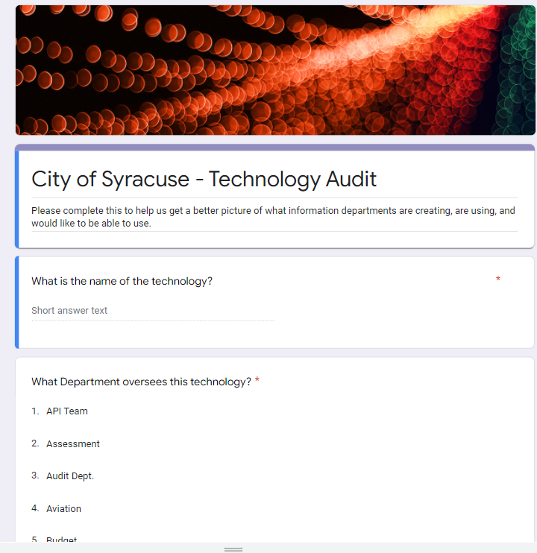
Audit
Technology Audit
We created a Google form with the Questions that we discussed last week (Meeting 25).
Form can be viewed HERE.

Slide 20
Audit
Discussion
How would we like to move forward with this?
Send an email to the departments who have provided information (Police, Fire, Smart Cities)
Invite a representative from one of the departments to share information to the group about the different technologies
Perform a site visit to try to get a better sense for how the data looks and is used

Slide 21
Membership Commitment Letter
Letter of Commitment:
Please complete and sign your 2022 STWG Membership Commitment Letter
Link to the PDF of this is HERE

Slide 22
Votes
STWG Member | Vote in Favor | Vote in Favor w/Stipulations | Vote Against | Abstention | Absence
Kelsey May
Sharon Owens
Martha Grabowski
Mark King
Ken Stewart
Chief Tim Gleeson
Johannes Himmelreich
Jen Tifft
1st DC Richard Shoff

Slide 23
Votes
STWG Member | Vote in Favor | Vote in Favor w/Stipulations | Vote Against | Abstention | Absence
Daniel Schwarz
Mujtaba Tirmizey
Michelle Sczpanski
Nico Diaz
Jason Scharf

