Slide 1
Surveillance Technology Working Group
Meeting #43
4/04/2023

Slide 2
Agenda
New Member introduction – Jawwaad Rasheed, Chief Accountability Officer with the SPD
ALPR Public Comment Discussion
ALPR Guidelines Discussion
ALPR Vote (If time allows)
Coming Up
Questions

Slide 3
Reference Slides

Slide 4
Review
Past Decisions
Fotokite: Aerial UAS allowing for different perspectives during crisis response. Not exempt, will go through the process.
  Press Release out, done with public comment period
  Public comments received, received comments from SPD
  Recommendation was sent to the Mayor
Vacant Lot Monitoring: Sensor that detect changes in a scene to monitor lots for dumping. Not exempt, will go through the process.
  Press Release out, done with public comment period
  Public comments received, waiting for updated data from the requesting department
Community Asset Tracker: Camera with machine learning algorithm to identify objects within the city.
  Assessed pilot, documentation provided
COPS: Cameras strategically placed around the city to aid in policing
  Exempted

Slide 5
Review
Past Decisions
Samsara: Fleet management technology
  Assessed in previous session
  Public comment period completed
  Recommendation was sent to the Mayor on 2/01
  Mayor Walsh stated that he read the read the groups recommendations, and is in agreement with a qualified approval, and is in agreement with the importance of putting in appropriate policies and procedures.
Flock Safety/ALPRs: Street cameras that capture vehicle plates.
  Assessed in previous session
  Public comment period completed
  The Work Group heard from SPD Officers on 1/25/22 for more information regarding this.
  The STWG created guidelines for ALPR Use and this was recommended to the mayor with the stipulations written on 3/11/22.

Slide 6
Review
Past Decisions
Cyclomedia: Right of Way Imaging
  Public comment period completed
  Recommendation was sent to the Mayor on 5/07/22
  Mayor Walsh stated: I have reviewed the STWG’s recommendation and I am in agreement with it.
Dataminr: Social Media monitoring of violent posts.
  Dataminr staff met with STWG on 6/21/2022.
  Dataminr then removed their offer of service on 6/21/2022.
Rubicon: Vehicle route optimization software
  STWG met on 9/27/22 and this was determined to not be a form of Surveillance
Opticom: Software that in an event of an emergency the Fire Department could switch the traffic lights on their route to turn green for them.
  STWG met on 12/06/22 and this was determined to not be a form of Surveillance

Slide 7
Review
Internal Norms
Attendance:
If members have unjustified absences for three meetings in a three month time period, the Surveillance Team Working Group (STWG) Coordinators will reach out to the member.
The working group is required to have at least 50% of all members present before we hold a recommendation vote.
  Of those present at least 40% should be non-city staff.
External Participants:
Outside participants should request permission before-hand to the API team.
  The API team will inform the STWG before meetings if there will be outside participants joining the group.
Documentation for Community Review:
The notes from the STWG Sessions will be posted to the STWG Website after the meetings.
Letter of Commitment:
Is effective for one year, and is to be sent out annually.
View Attendance and Guest Norms

Slide 8
Review
Service Level Agreements (SLAs)
2 - 6 Weeks
(10 - 30
Business Days)
Every 2 Weeks
(10 Business Days)
2 Weeks
(10 Business Days)
2 Weeks
(10 Business Days)
Initial submission to determination of surveillance
Short duration meeting to vote on technology exemptions
Public comment period:
Issuance of press release
Council meeting
(*) For now public input will be received via a Google Form and in the future will be on the new website.
Submission of finalized form (by dept.) to time of recommendation.
Group will individually research; departments will get follow-up questions; group to vote yes/no; and submit recommendation.

Slide 9
STWG Long Term Plan (Review)
Update STWG Website
Tech Recommendations
Meeting Notes and Slide Decks
Connect with other cities doing surv. tech work
Revamp our approach to community engagement
Complete Citywide departmental training
Determine Schedule for refresher trainings (annually or every 6 months)
Complete an audit of technologies currently used by the City as Surveillance or Not
Release an Annual Report
Including recommendations, data that came from recommendations, and if stipulations are being followed.
Short Term
(April – June 2022)
Medium Term
(July – September 2022)
Long term
(October – December 2022)

Slide 10
STWG Long Term Plan (Review)
Begin process of trying to transfer STWG to a City Ordinance
Determine Member’s Term Duration
Requires more planning

Slide 11
Technology Audit Roadmap (Review)
Review List of technology (Make initial determination if “Not Surveillance” or “Need more information”)
For flagged technologies, send Technology Audit Form requesting more info.
When information is received, group votes on whether identified technology will be characterized as surveillance.
Go through same process as Digital Services
In addition, try to schedule a site visit to be able to find more information about how technologies are used.
Go through same process as Digital Services and Fire Dept.
In addition, try to schedule a site visit to be able to find more information about how technologies are used.
Digital Services
Fire Department
Syracuse Police Dept

Slide 12
Definition
Definition of a Surveillance Technology (According to Mayor’s Executive Order on Surveillance Technology):
Technologies that “observe or analyze the movements, behavior, or actions of identifiable individuals in a manner that is reasonably likely to raise concerns about civil liberties, freedom of speech or association, racial equity or social justice.”

Slide 13
Technology Audit
Digital Services provided a list of City Software used
  List can be viewed HERE
Chief Gleeson provided the list of technology from the Fire Department
  He also completed the survey assessment for this technology.
  Results can be viewed HERE.
List of technology provided from the Syracuse Police Department are:
  Documentation can be viewed HERE.
List of technology provided from Strategic Initiatives / Internet of things
  Documentation can be viewed HERE

Slide 14
Meeting slides

Slide 15
LPR Technology Summary
Applicant name: SPD Company: TBD Sponsoring Department: Syracuse Police Department | Application Date: 2/28/23 Partner Organization/Technologies: TBD (Currently in RFP Committee) | Proof of Concept Demonstration? Technology Implementation? Exempt?
Technology Purpose: Street cameras that capture still photos and also vehicle license plates to aid police with investigations and apprehension of suspect after criminal activity has occurred. |  | Operation/Implementation description: The technology will be installed on free-standing poles on city streets or in overlays of currently existing cops cameras. Locations were chosen consulting analysts and officers. 26 locations were pinpointed, covering the entire City.
Data Management Plan: TBD Retention follows standards set by the New York State Educational Law. Cloud vs on prem: TBD | Intended Operation: The technology will be permanently installed and will operate continuously. This technology will assist the Syracuse Police Department in its mission to make the city safer by improving their ability to more swiftly and effectively investigate criminal activity, as well as, apprehend those committing the crimes. | Maintainability/Scalability/Reliability/Vulnerabilities: Unknown Cybersecurity Plan: Audit trails and passwords that track what data is pulled Broader Impacts/Unintended Consequences/Concerns: Unknown | Who is the audience for this system?: Training detectives (SPOs watch cameras) - not every officer. How many units/how is the system deployed?: 26 cameras primarily near on and off ramps, to assist on investigations Volume, size and type of data: Images, size TBD Length of time application is expected to be used: Indefinitely
X

Slide 16
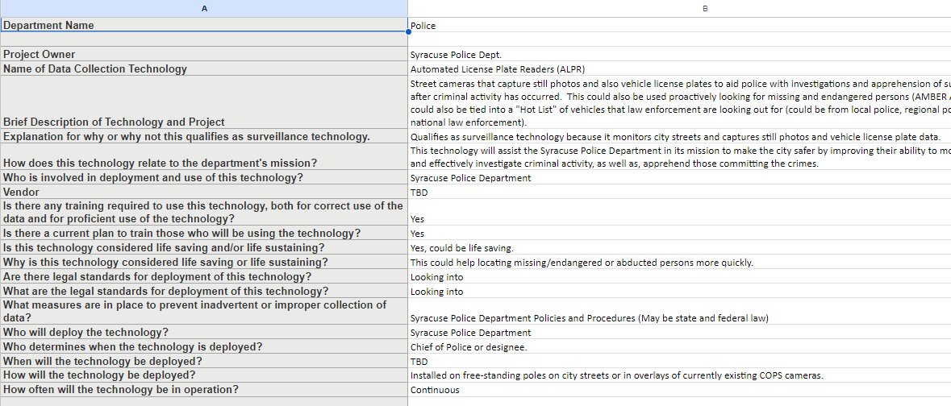
Automated License Plate Readers (ALPR) Discussion
  Chief Shoff updated the ALPR Data Collection Technology Form
  Full form can be viewed HERE

Slide 17
Automated License Plate Readers (ALPR) Discussion
Public Comment Period for the Technology was from 3/10 - 3/24
We received 254 responses, link is HERE
The tallies are:
    Those with a Positive view of the technology: 87
  Those with a Negative view of the technology: 104
  Those whom have additional questions/neutral opinion: 34
  Uncompleted entries: *29 (want to revise form for next technology)

Slide 18
Automated License Plate Readers (ALPR) Discussion
  Discussion
  Are there any concerns raised in the public comments that members would like to discuss?

Slide 19
Communication Strategy Discussion
  Revisit our strategy for communicating additional information about the technology
  Working on a Frequently asked Questions document for the ALPR HERE
  Any volunteers to help review this?
Public Comment Period
Identify Frequently Asked Questions
Send completed FAQ's to group of emails
Post the information to STWG Website
Constituents can submit a request to Mayor or Press Office(*)

Slide 20
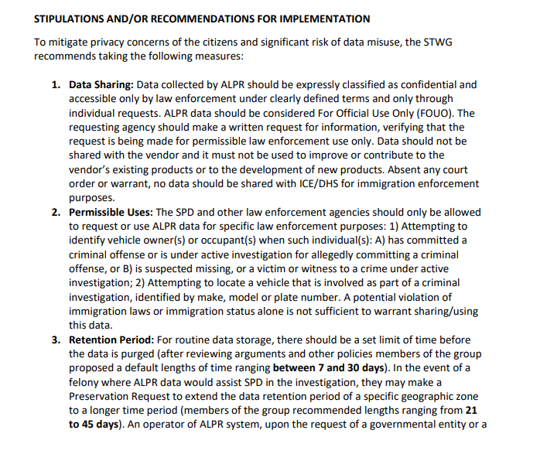
Automated License Plate Readers (ALPR) Discussion
  Previous Stipulations that we had drafted can be viewed HERE
  We wanted to start to go through some of the sections individually.

Slide 21
Automated License Plate Readers (ALPR) Discussion
  Data Sharing: Data collected by ALPR should be expressly classified as confidential and accessible only by law enforcement under clearly defined terms and only through individual requests. ALPR data should be considered For Official Use Only (FOUO). The requesting agency should make a written request for information, verifying that the request is being made for permissible law enforcement use only. Data should not be shared with the vendor and it must not be used to improve or contribute to the vendor’s existing products or to the development of new products. Absent any court order or warrant, no data should be shared with ICE/DHS for immigration enforcement purposes.
  Any revisions that folks would like made to this?

Slide 22
Automated License Plate Readers (ALPR) Discussion
  2. Permissible Uses: The SPD and other law enforcement agencies should only be allowed to request or use ALPR data for specific law enforcement purposes: 1) Attempting to identify vehicle owner(s) or occupant(s) when such individual(s): A) has committed a criminal offense or is under active investigation for allegedly committing a criminal offense, or B) is suspected missing, or a victim or witness to a crime under active investigation; 2) Attempting to locate a vehicle that is involved as part of a criminal investigation, identified by make, model or plate number. A potential violation of immigration laws or immigration status alone is not sufficient to warrant sharing/using this data.
  Any revisions that folks would like made to this?

Slide 23
Automated License Plate Readers (ALPR) Discussion
  3. Retention Period: For routine data storage, there should be a set limit of time before the data is purged (after reviewing arguments and other policies members of the group proposed a default lengths of time ranging between 7 and 30 days). In the event of a felony where ALPR data would assist SPD in the investigation, they may make a Preservation Request to extend the data retention period of a specific geographic zone to a longer time period (members of the group recommended lengths ranging from 21 to 45 days).
  An operator of ALPR system, upon the request of a governmental entity or a defendant in a criminal case, shall take all necessary steps to preserve ALPR data in their possession for 14 days pending the issuance of a court order. A requesting governmental entity or defendant in a criminal case must specify in a written sworn statement: the particular camera or cameras for which captured plate data must be preserved or the particular license plate for which captured plate data must be preserved; and the date(s) and/or timeframe for which captured plate data must be preserved. In the event where ALPR data has been brought into Court as evidence to assist in a Law Enforcement investigation, these guidelines allow for this data to be accessible for a longer period of time as is the procedure with other data captured by SPD.
  Any revisions that folks would like made to this?

Slide 24
Automated License Plate Readers (ALPR) Discussion
  4. Addressing Accuracy Limitations of the Technology: An evaluation of ALPR accuracy rates should be part of the training of all officers and officials who use and have access to the technology. SPD should establish proper training and clear procedures for addressing ALPR mismatch avoid unwarranted detainment. For example, plates should be confirmed visually before a stop if possible, and at minimum, they should be confirmed as soon as the officer exits the patrol vehicle.
  Any revisions that folks would like made to this?

Slide 25
Automated License Plate Readers (ALPR) Discussion
  5. Reporting and Audits: SPD will post its ALPR system use policy and privacy policy on its publicly available website. SPD will report at the end of the pilot period on its ALPR practices and usage to the Mayor’s office and the STWG. The report will also be conspicuously posted on SPD’s website and on the STWG website. The report shall include: the locations and specifications of all cameras used for the ALPR system;
  the number of license plates scanned;
  the total number of incidents (DR #’s) investigated in which an LPR match was generated, total number of incidents (DR #s) investigated that did not generate a match, the number of confirmed matches, and the number of matches that upon further investigation did not correlate to an alert;
  Of all incidents investigated that had related ALPR matches, related offenses that were verified subsequent to the match, broken out by offense type, subsequent arrests that occurred in relation to those offenses, broken out by arrest type, charges filed subsequent to related arrests;
  the number of manually-entered license plate numbers, broken down by reason justifying the entry and corresponding DR#s, the number of confirmed matches, and the number of matches that upon further investigation did not correlate to an alert;
  any changes to the ALPR system or to the use or privacy policy;
  data on accuracy, including date and time, for each instance of a false match.

Slide 26
Votes
STWG Member | Vote in Favor | Vote in Favor w/Stipulations | Vote Against | Abstention | Absence
Timothy Liles
Sharon Owens
Martha Grabowski
Mark King
Chief Tim Gleeson
Johannes Himmelreich
Jen Tifft
1st DC Richard Shoff

Slide 27
Votes
STWG Member | Vote in Favor | Vote in Favor w/Stipulations | Vote Against | Abstention | Absence
Daniel Schwarz
Mujtaba Tirmizey
Michelle Sczpanski
Nico Diaz
Jason Scharf
Ocesa Keaton
Jawwaad Rasheed

Slide 28
Coming Up
Meeting with DPW around school zone speed enforcement
ALPR: Final discussion and begin writing recommendation to the Mayor
Audit:
                Review sessions with department heads
                Provide feedback
                Final draft

Slide 29
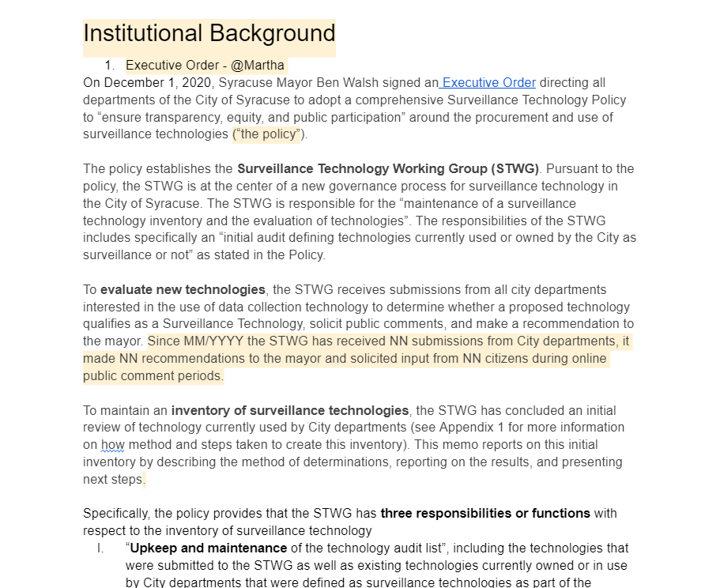
City Wide Technology Audit
The template that we put together so far can be viewed here:
Review updates on different sections

Slide 30
Questions
?

