Slide 1
Surveillance Technology Working Group
Meeting #16 12.14.2021

Slide 2
Agenda
Welcome - Professor Yue Han & David Brown
Press Release - Update
Holiday Update
Coming Up
Questions

Slide 3
Review
Past Decisions
Fotokite: Aerial UAS allowing for different perspectives during crisis response. Not exempt, will go through the process.
Press Release out, done with public comment period
Public comments received, received comments from SPD
Recommendation sent to the Mayor
Vacant Lot Monitoring: Sensor that detect changes in a scene to monitor lots for dumping. Not exempt, will go through the process.
Press Release out, done with public comment period
Public comments received, waiting for updated data from the requesting department
Community Asset Tracker: Camera with machine learning algorithm to identify objects within the city.
Assessed pilot, documentation provided
COPS: Cameras strategically placed around the city to aid in policing
Exempted

Slide 4
Review
Current Decisions
Flock Safety: Street cameras that capture vehicle plates.
Assessed in previous session
Public comment period open until December 21st
Samsara: Fleet management technology
Assessed in previous session
Public comment period open until December 21st

Slide 5
Review
SLAs
2 - 6 Weeks
(10 - 30
Business Days)
Every 2 Weeks
(10 Business Days)
2 Weeks
(10 Business Days)
2 Weeks
(10 Business Days)
Initial submission to determination of surveillance
Short duration meeting to vote on technology exemptions
Public comment period:
Issuance of press release
Council meeting
(*) For now public input will be received via a Google Form and in the future will be on the new website.
Submission of finalized form (by dept.) to time of recommendation.
Group will individually research; departments will get follow-up questions; group to vote yes/no; and submit recommendation.

Slide 6
Press Release
Update
Press release for Samsara and Flock Safety went out on December 7th calling for comments from the public.
The open public comment period will close on December 21st.
There currently have 90 comments from the public.
CLICK HERE to see the article

Slide 7
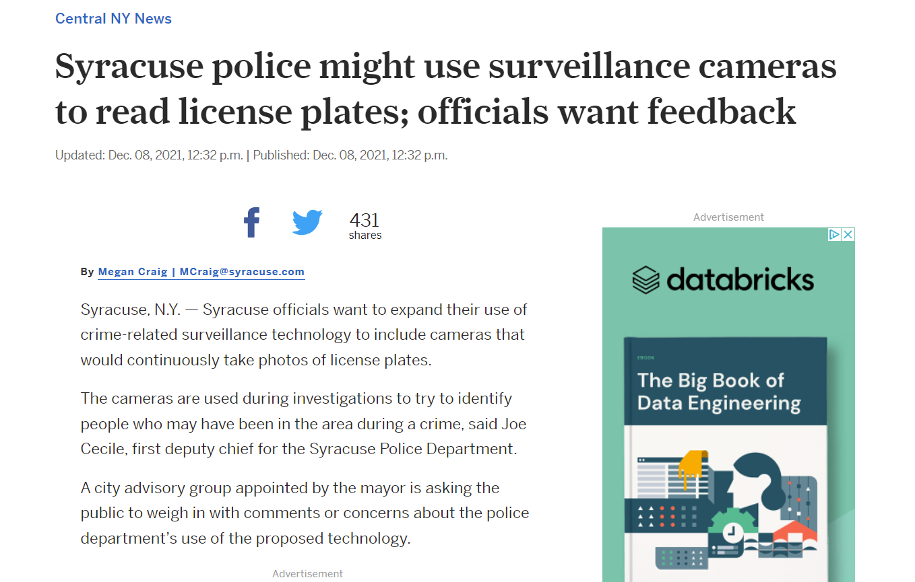
Press Release
https://www.syracuse.com/news/2021/12/syracuse-police-might-use-surveillance-cameras-to-read-license-plates-officials-want-feedback.html

Slide 8
Holiday Update
Update
We will NOT be meeting on Tuesday December 28th - Happy Holidays!

Slide 9
Coming Up
We will send Public Comment feedback to the departments to get their responses
Members are encouraged to add questions through the public comment period for things that haven’t been addressed
Next time we meet we will reviewing the responses to the public comments provided by Departments.

Slide 10
Questions
?

