Slide 1
Surveillance Technology Working Group
Meeting #18 1.25.2022

Slide 2
Agenda
Welcome Jason!
Samsara
Review recommendation to the Mayor draft
Vote on recommendation
License Plate Reader (LPR)
Review and discuss recommendations spreadsheet
Formal recommendation to the Mayor - discussion/decision
Coming Up
Questions

Slide 3
Review
Past Decisions
Fotokite: Aerial UAS allowing for different perspectives during crisis response. Not exempt, will go through the process.
Press Release out, done with public comment period
Public comments received, received comments from SPD
Recommendation sent to the Mayor
Vacant Lot Monitoring: Sensor that detect changes in a scene to monitor lots for dumping. Not exempt, will go through the process.
Press Release out, done with public comment period
Public comments received, waiting for updated data from the requesting department
Community Asset Tracker: Camera with machine learning algorithm to identify objects within the city.
Assessed pilot, documentation provided
COPS: Cameras strategically placed around the city to aid in policing
Exempted

Slide 4
Review
Current Decisions
Flock Safety: Street cameras that capture vehicle plates.
Assessed in previous session
Public comment period completed
Samsara: Fleet management technology
Assessed in previous session
Public comment period completed

Slide 5
Review
SLAs
2 - 6 Weeks
(10 - 30
Business Days)
Every 2 Weeks
(10 Business Days)
2 Weeks
(10 Business Days)
2 Weeks
(10 Business Days)
Initial submission to determination of surveillance
Short duration meeting to vote on technology exemptions
Public comment period:
Issuance of press release
Council meeting
(*) For now public input will be received via a Google Form and in the future will be on the new website.
Submission of finalized form (by dept.) to time of recommendation.
Group will individually research; departments will get follow-up questions; group to vote yes/no; and submit recommendation.

Slide 6
Welcome
Welcome Jason Scharf!

Slide 7
Samsara Technology Summary
Applicant name: Rich DeVesty Company: City of Syracuse - DPW Sponsoring Department: Fleet Operations | Application Date: 11/14/21 Partner Organization/Technologies: Samsara | Proof of Concept Demonstration? Technology Implementation? Exempt?
Technology Purpose: To provide real time tracking of DPW vehicles and equipment and to provide camera images along routes. |  | Operation/Implementation description: The technology will be installed on DPW trucks and equipment.
Data Management Plan: Fleet Operations will have access to the data through a web portal. The data will live and be available for 10 years. Access to this data is guarded by credentials. Only Superintendents will have access to this data Cloud vs on prem: Cloud-based server | Intended Operation: The technology will be permanently installed and will operate continuously. This technology will assist the DPW in both tracking their vehicles but also in ensuring the safety and accountability for their crews as there are front facing cameras that are included | Maintainability/Scalability/Reliability/Vulnerabilities: Unknown Cybersecurity Plan: Unknown Broader Impacts/Unintended Consequences/Concerns: Unknown | Who is the audience for this system?: DPW Supervisors and Administration How many units/how is the system deployed?: Unknown Volume, size and type of data: ICamera footage Length of time application is expected to be used: Indefinitely
X

Slide 8
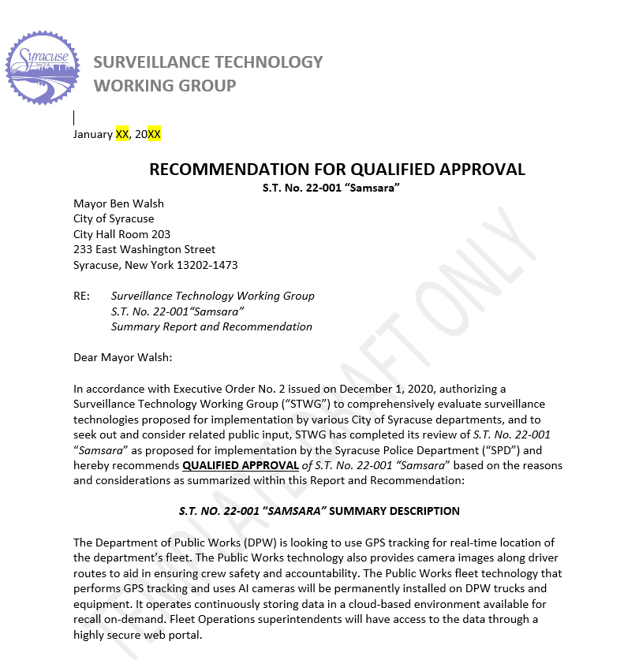
Samsara
Proposed recommendation:
Qualified Approval
STWG recommends adopting the following procedures:
Draft a written policy for accessing video footage
Establish a formal process to share video footage with other departments
Reduce the data retention period (from 10 years)
Request the vendor to have a clear cybersecurity plan, data breach policy, and add incentives to comply

Slide 9
Samsara
Votes
STWG Member | Vote in Favor | Vote in Favor w/Stipulations | Vote Against | Abstention | Absence
Kelsey May |  | X
Sharon Owens |  |  |  |  | X
Martha Grabowski |  | X
Mark King |  | X
Ken Stewart |  | X
Chief Gleeson |  |  |  |  | X
Johannes Himmelreich |  | X
Ocesa Keaton |  | X
Jen Tifft |  |  |  |  | X

Slide 10
Samsara
Votes
STWG Member | Vote in Favor | Vote in Favor w/Stipulations | Vote Against | Abstention | Absence
Lanessa Chaplin |  |  |  |  | X
Mujtaba T. |  | X
Michelle S. |  |  |  |  | X
Jake Dishaw |  |  |  |  | X
John Kane |  |  |  |  | X
Brian Eisenberg |  |  |  |  | X
Nico Diaz |  | X
Jessica Brandt |  | X
Chief Cecile |  | X

Slide 11
LPR Technology Summary
Applicant name: SPD Company: Flock Safety Sponsoring Department: Syracuse Police Department | Application Date: 10/04/21 Partner Organization/Technologies: Flock Safety | Proof of Concept Demonstration? Technology Implementation? Exempt?
Technology Purpose: Street cameras that capture still photos and also vehicle license plates to add police with investigations and apprehension of suspect after criminal activity has occurred. |  | Operation/Implementation description: The technology will be installed on free-standing poles on city streets or in overlays of currently existing cops cameras. Locations were chosen consulting analysts and officers. 57 locations were pinpointed, covering the entire City. Pilot will run for 90 days.
Data Management Plan: The data will be collected and stored by Flock Safety and retained for one month and will be destroyed with and auto override. SPD will be responsible for ensuring compliance. Retention follows standards set by the New York State Educational Law. Cloud vs on prem: Cloud-based server (evidence.com) | Intended Operation: The technology will be permanently installed and will operate continuously. This technology will assist the Syracuse Police Department in its mission to make the city safer by improving their ability to more swiftly and effectively investigate criminal activity, as well as, apprehend those committing the crimes. | Maintainability/Scalability/Reliability/Vulnerabilities: Cybersecurity Plan: Audit trails and passwords that track what data is pulled Broader Impacts/Unintended Consequences/Concerns: | Who is the audience for this system?: Training detectives (SPOs watch cameras) - not every officer. How many units/how is the system deployed?: 75 cameras on on-off ramps, to assist on investigations Volume, size and type of data: Images, size TBD Length of time application is expected to be used: Indefinitely
X

Slide 12
License Plate Reader
Outstanding questions answered by Mujtaba:
1. What consent is granted when someone obtains a driver’s license?
A driver impliedly consents to LPRS capturing and storing their license plate number when they obtain a driver’s license.
License plates are public information, they are visible on public roads and are displayed outside the vehicle, so the reasonable expectation of privacy is lower in public-facing items.
Police departments across the US (including in NY) are using LPRS for legitimate police business with established operating guidelines for the use, maintenance and control of LPRS.

Slide 13
License Plate Reader
2. Accountability regarding the data collected.
Many privacy concerns have been mitigated by holding law enforcement agencies accountable for the information they collect and how they subsequently use that information. Here are some tools commonly used by organizations using LPRS:
Audit Logs: The primary goal of maintaining audit logs is to deter and discover users’ abuse and misuse of a LPRS. Such audit capabilities can be an effective means to discourage unnecessary or inappropriate use of LPR data and trace any improper uses to the offending party. For effective use, audit logs should include certain information: (1) the identity of the user initiating the query; (2) the license plate number or other data elements used to query the LPRS; (3) the date and time of the inquiry; and (4) the response to the user’s query.
Secondary Dissemination Logs: Since LPR data is for official use only, and because LPR data is collected for specified purposes, instances where LPR data is disseminated outside the originating agency should be documented in a secondary dissemination log. When information from a LPRS is disseminated outside the law enforcement agency, a log should be maintained that contains: (1) a description of the LPR data disseminated; (2) the date and time the information was released; (3) the identity of the individual to whom the information was released, including their agency and contact information; and (4) the purpose for which the LPR data will subsequently be used.

Slide 14
License Plate Reader
Continued…
Monitoring and Conducting Audits of System Use: Audits of LPRS help to ensure that law enforcement agencies are operating in accordance with the policies developed to regulate the collection, use, and dissemination of LPR data. An audit of a LPRS involves an evaluation of the law enforcement agency’s operations as recorded in its audit logs to determine if the agency is administering its LPRS in accordance with its information management policies. LPRS audits should focus on ensuring that LPR data is only disclosed to authorized users and that the information is utilized for official purposes only. Existing law enforcement data systems already have policies that include prohibitions against misuse of criminal justice data; those policies also frequently impose penalties for such misuse.
Policy Awareness and Training: Personnel employed by law enforcement agencies should be informed about why policies limiting access, use, and dissemination of LPR data are important and how those policies protect the agency and the public. Moreover policy education and awareness surrounding LPRS is a continual process that must be regularly updated as laws and regulations governing LPR data or law enforcement’s access to information change over time. Users should be educated and informed about how LPR policies will be enforced, including any penalties for committing violations of the policy provisions. Law enforcement agencies should monitor relevant legislative and regulatory activity and update LPRS policies accordingly. When policies are updated, those individuals having access to LPR data should be informed of the changes and when those new terms take effect.

Slide 15
License Plate Reader
Intended use of LPRs
Deputy Chief Cecile

Slide 16
License Plate Reader
Recommendation SpreadSheet

Slide 17
License Plate Reader
Discussion
Should the City adopt this technology?
Do we see substantial risks in the use of this technology?
Are there policies and procedures that the issuing department should adopt to avoid any risks?

Slide 18
Coming Up
Send Samsara recommendation to the Mayor
Draft formal recommendation from the group for LPR

Slide 19
Questions
?

