Slide 1
Surveillance Technology Working Group
Meeting #24 4.26.2022

Slide 2
Agenda
Cyclomedia - Right of Way Imaging (Discuss Public Comments)
Discussion on Cyclomedia Technology
Vote on Cyclomedia (Right of Way Imaging)
Brief update on Surveillance Tech Working Group Website
Coming Up
Questions

Slide 3
Review
Past Decisions
Fotokite: Aerial UAS allowing for different perspectives during crisis response. Not exempt, will go through the process.
Press Release out, done with public comment period
Public comments received, received comments from SPD
Recommendation was sent to the Mayor
Vacant Lot Monitoring: Sensor that detect changes in a scene to monitor lots for dumping. Not exempt, will go through the process.
Press Release out, done with public comment period
Public comments received, waiting for updated data from the requesting department
Community Asset Tracker: Camera with machine learning algorithm to identify objects within the city.
Assessed pilot, documentation provided
COPS: Cameras strategically placed around the city to aid in policing
Exempted

Slide 4
Review
Current Decisions
Samsara: Fleet management technology
Assessed in previous session
Public comment period completed
Recommendation was sent to the Mayor on 2/01
Mayor Walsh stated that he read the read the groups recommendations, and is in agreement with a qualified approval, and is in agreement with the importance of putting in appropriate policies and procedures.
Flock Safety/ALPRs: Street cameras that capture vehicle plates.
Assessed in previous session
Public comment period completed
The Work Group heard from SPD Officers on 1/25/22 for more information regarding this.
The STWG created guidelines for ALPR Use and this was recommended to the mayor with the stipulations written on 3/11/22.

Slide 5
Review
Internal Norms
Attendance:
If members have unjustified absences for three meetings in a three month time period, the Surveillance Team Working Group (STWG) Coordinators will reach out to the member.
The working group is required to have at least 50% of all members present before we hold a recommendation vote.
Of those present at least 40% should be non-city staff.
External Participants:
Outside participants should request permission before-hand to the API team.
The API team will inform the STWG before meetings if there will be outside participants joining the group.
Documentation for Community Review:
The notes from the STWG Sessions will be posted to the STWG Website after the meetings.
Letter of Commitment:
Is effective for one year, and is to be sent out annually.
View Attendance and Guest Norms

Slide 6
Review
Service Level Agreements (SLAs)
2 - 6 Weeks
(10 - 30
Business Days)
Every 2 Weeks
(10 Business Days)
2 Weeks
(10 Business Days)
2 Weeks
(10 Business Days)
Initial submission to determination of surveillance
Short duration meeting to vote on technology exemptions
Public comment period:
Issuance of press release
Council meeting
(*) For now public input will be received via a Google Form and in the future will be on the new website.
Submission of finalized form (by dept.) to time of recommendation.
Group will individually research; departments will get follow-up questions; group to vote yes/no; and submit recommendation.

Slide 7
Cyclomedia - New Request
Applicant name: Neil Burke Company: Cyclomedia Sponsoring Department: City of Syracuse - DPW | Application Date: 2/24/2022 Partner Organization/Technologies: Cyclomedia | Proof of Concept Demonstration? Technology Implementation? x Exempt?
Technology Purpose: Cyclomedia allows for desktop review of accurate and up-to-date information regarding traffic control devices. DPW oversees the public ROW and responds to issues every day of the year, this tool helps streamline our workflow and reduce miles traveled/field work - these two factors relate to resource management and safety, the less of either the better. |  | Operation/Implementation description: We will enter into a multi-year agreement, including 3 captures.
Data Management Plan: DPW and Assessment will have access to the data through a web portal. The data will live and be available for 24 months after each capture. Access to this data is guarded by credentials. Cloud vs on prem: Cloud-based server | Intended Operation: Cyclomedia would be a one time and temporary assessment of city streets. Cyclomedia provides Right of Way (ROW) imaging, somewhat similar to google streetview, provides accurate information without distortion and has accuracy/measurable data points for items in/viewable from ROW like signage, etc. | Maintainability/Scalability/Reliability/Vulnerabilities: Unknown Cybersecurity Plan: Unknown Broader Impacts/Unintended Consequences/Concerns: Unknown | Who is the audience for this system?: DPW and Assessment Staff How many units/how is the system deployed?: Unknown Volume, size and type of data: Unknown Length of time application is expected to be used: 5 Months

Slide 8
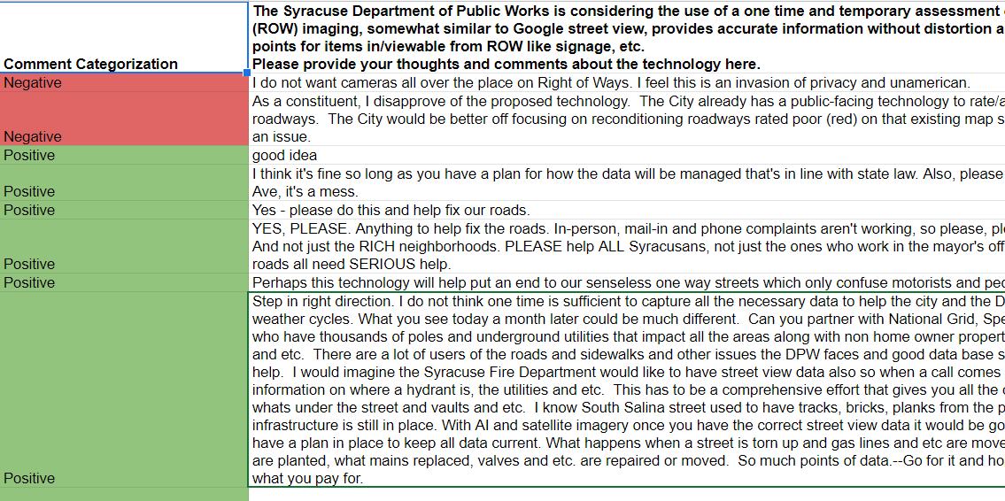
Cyclomedia - Update
Cyclomedia public comments can be viewed: HERE

Slide 9
Cyclomedia
Discussion
Should the City adopt this technology?
Any remaining questions?

Slide 10
Cyclomedia
Votes
STWG Member | Vote in Favor | Vote in Favor w/Stipulations | Vote Against | Abstention | Absence
Kelsey May |  |  |  |  | X
Sharon Owens |  |  |  |  | X
Martha Grabowski | X (Clarify)
Mark King | X
Ken Stewart |  |  |  |  | X
Chief Tim Gleeson | X
Johannes Himmelreich | X
Jen Tifft | X
Chief Joe Cecile | X

Slide 11
Cyclomedia
Votes
STWG Member | Vote in Favor | Vote in Favor w/Stipulations | Vote Against | Abstention | Absence
Daniel Schwarz |  |  |  | X
Mujtaba Tirmizey | X
Michelle Sczpanski | X
Nico Diaz | X
Jason Scharf | X

Slide 12
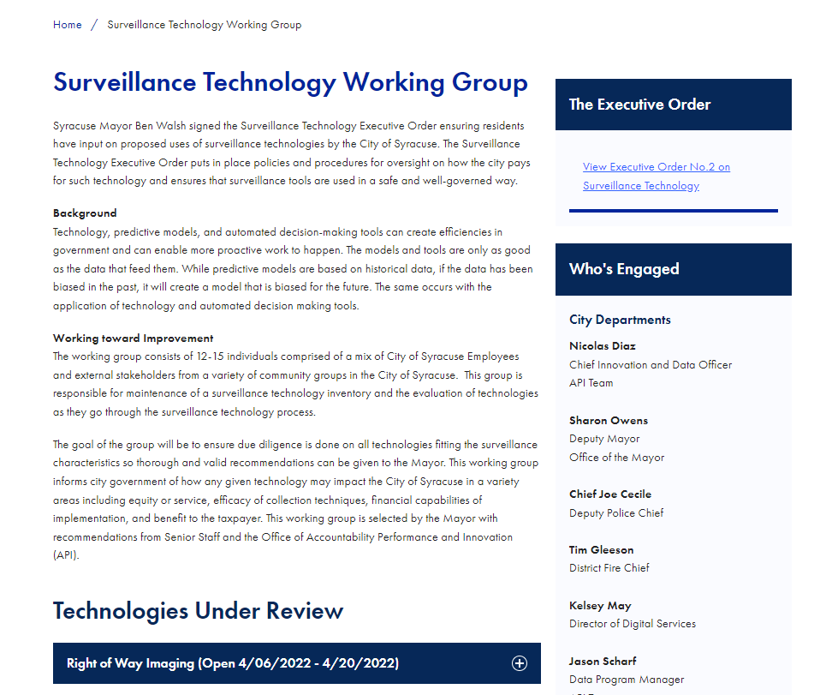
STWG Website Update
Posted list of current members
Final recommendations for technologies
Posting meeting minutes and Powerpoint slides
Including more information when we have public comment
Can be viewed HERE

Slide 13
Membership Commitment Letter
Letter of Commitment:
Please complete and sign your 2022 STWG Membership Commitment Letter
Link to the PDF of this is HERE

Slide 14
Coming Up
Technology Audit
Presenting the Surveillance Technology Working Group Long Term Plan to the Group
Continue reviewing technology requests as they are received

Slide 15
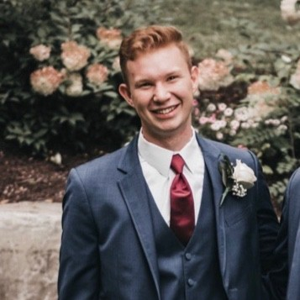
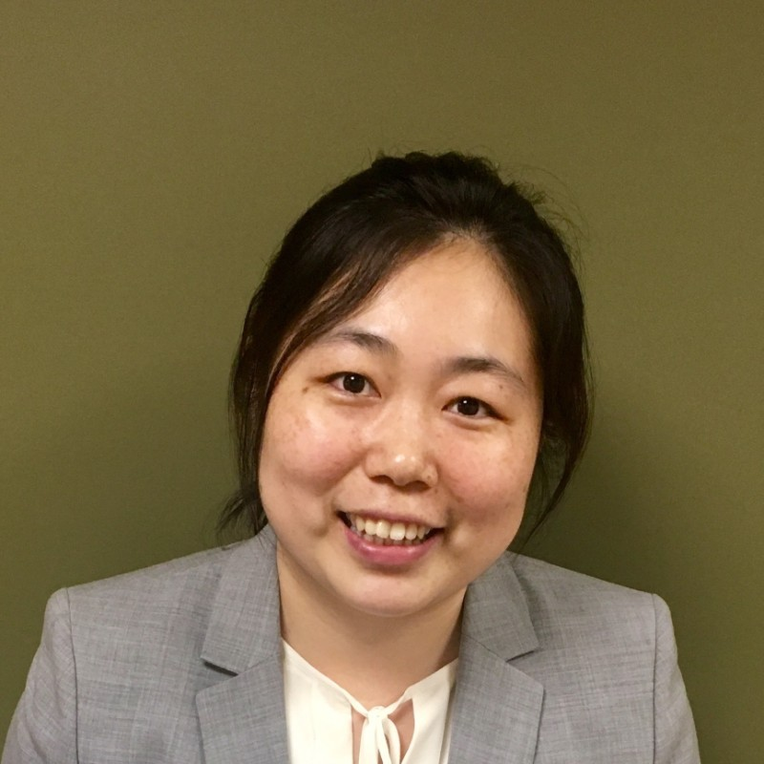
Introductions
Dan Brown,
MBA Analytics Student at Le Moyne College
Dr. Yue Han,
Assistant Professor of Information Systems at Le Moyne College

Slide 16
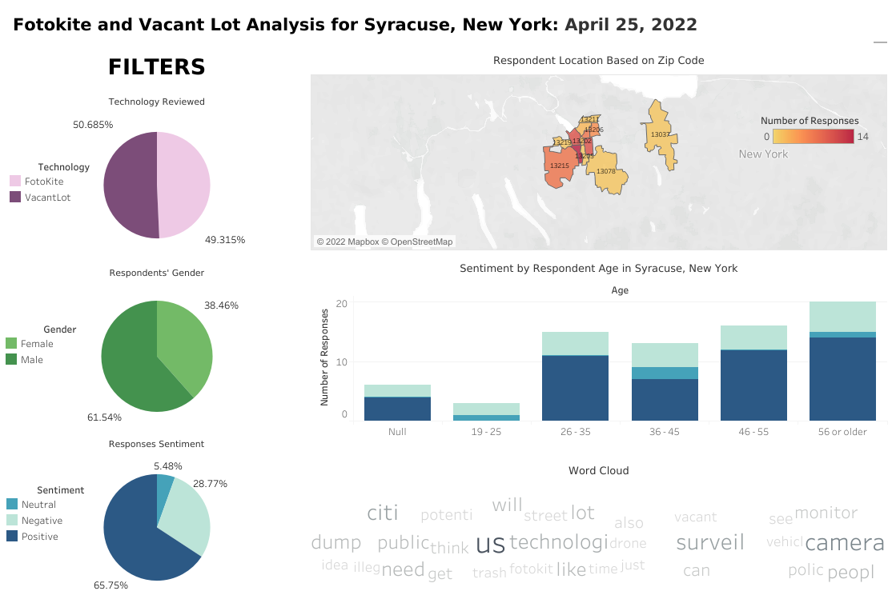
Dashboard can be explored: HERE

Slide 17
Cyclomedia - Update
Cyclomedia Press Release was put out on 4/06/2022 for Public Comment Period - HERE
Form can be accessed HERE

Slide 18
Questions
?

