Slide 1
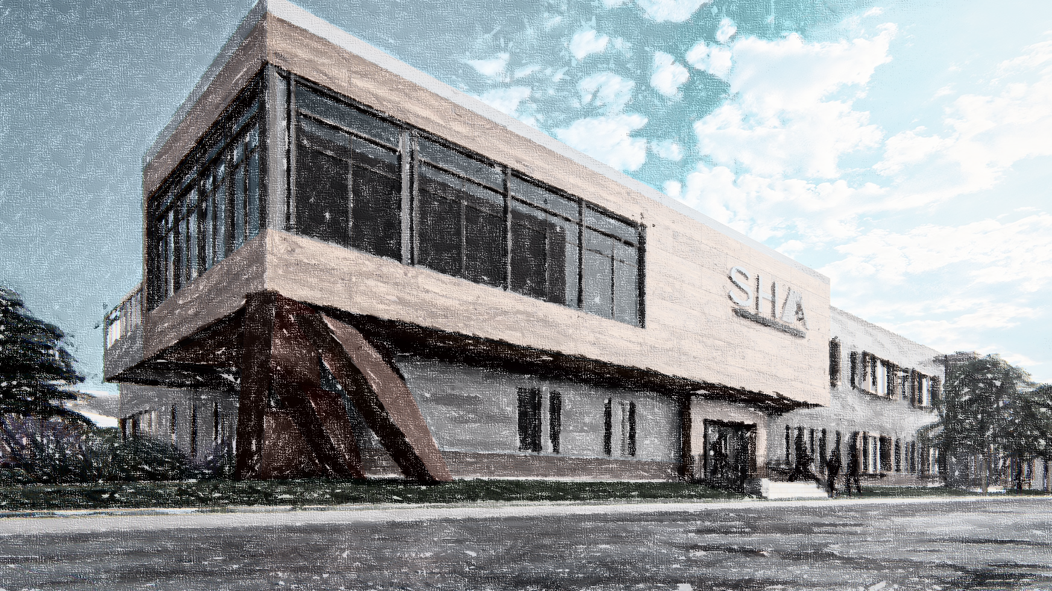

SYRACUSE HOUSING AUTHORITY
NEW CENTRAL OFFICES
CPC MEETING| 12 NOVEMBER 2024
Notes:
Syracuse Housing Authority is proposing the construction of a new central office building within the City of Syracuse in Onondaga County, New York. The project, located at 500-02 Burt Street, Syracuse, NY 13202, is located on a 1.70-acre parcel. The purpose of the project is to replace the current facility that has exceeded its useful life. The current facility is also located in an area that will be taken for the I-81 Viaduct Project.

Slide 2
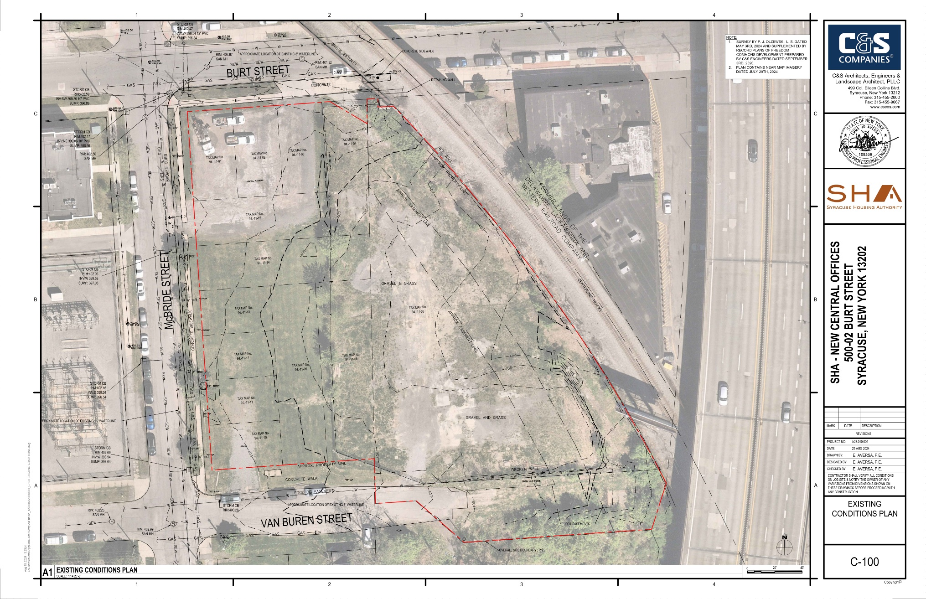
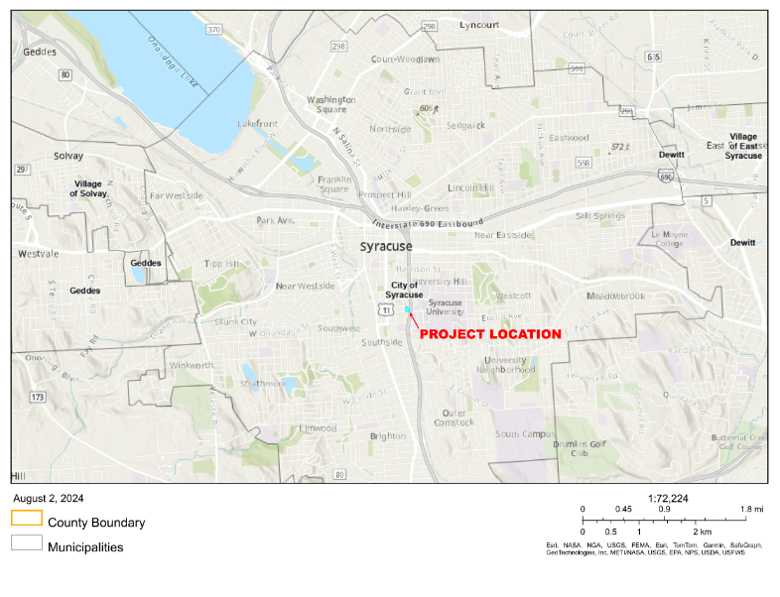
SYRACUSE HOUSING AUTHORITY
NEW CENTRAL OFFICES
EXISTING CONDITIONS:

Slide 3
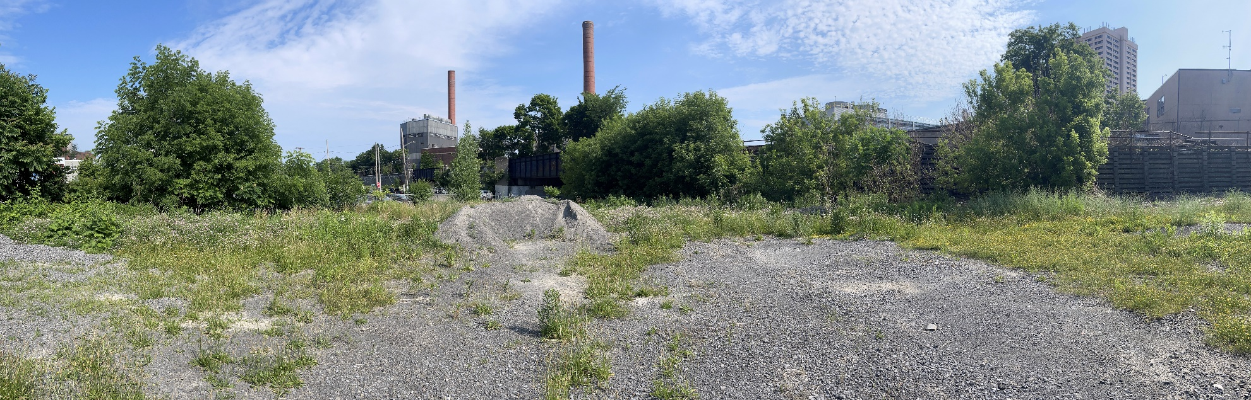
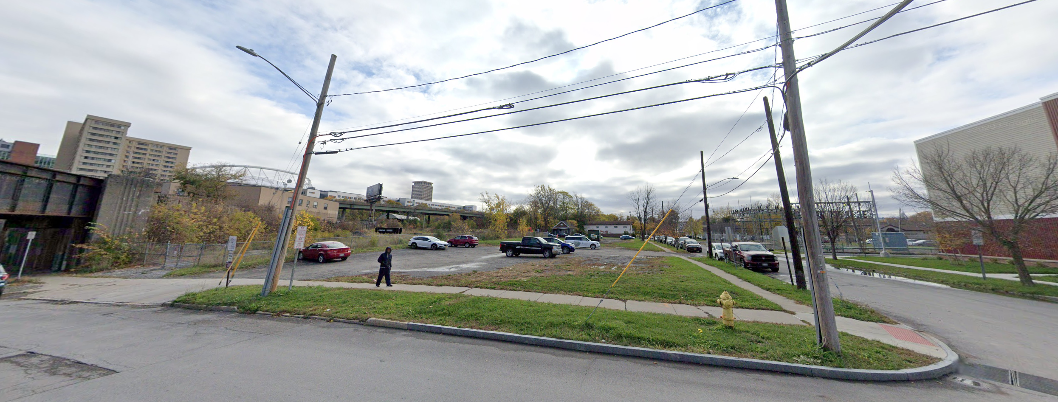
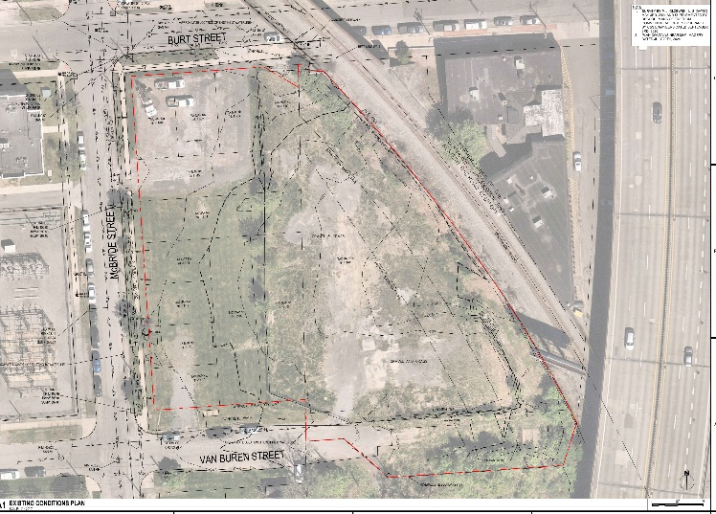
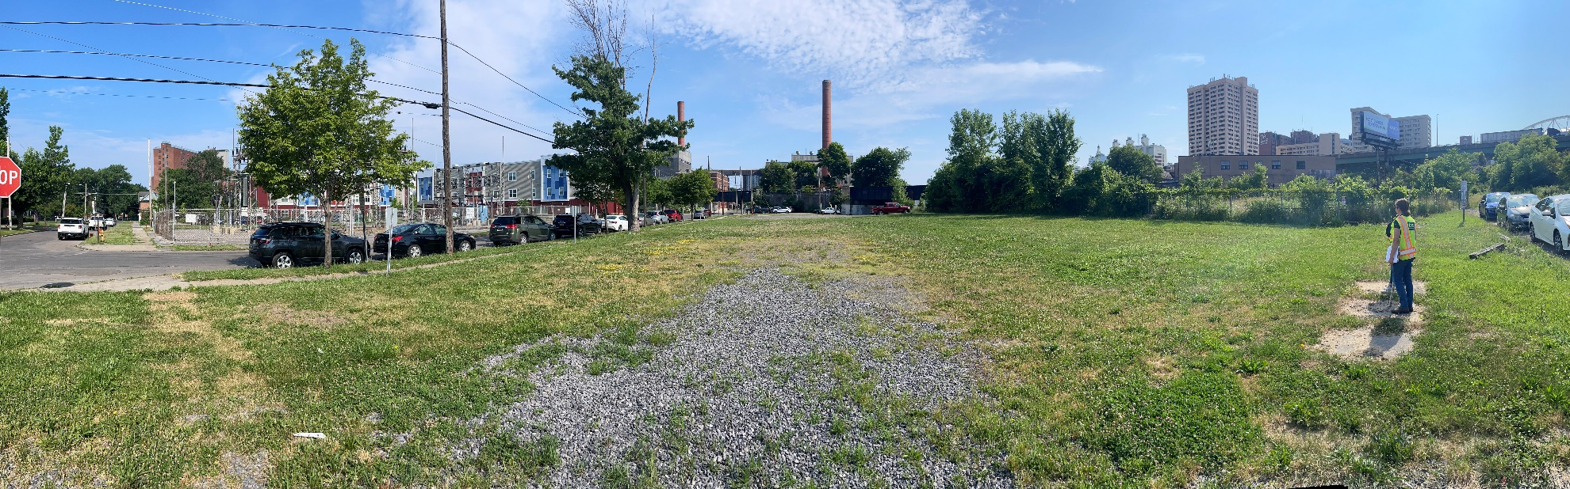
SYRACUSE HOUSING AUTHORITY
NEW CENTRAL OFFICES
EXISTING CONDITIONS:

Slide 4
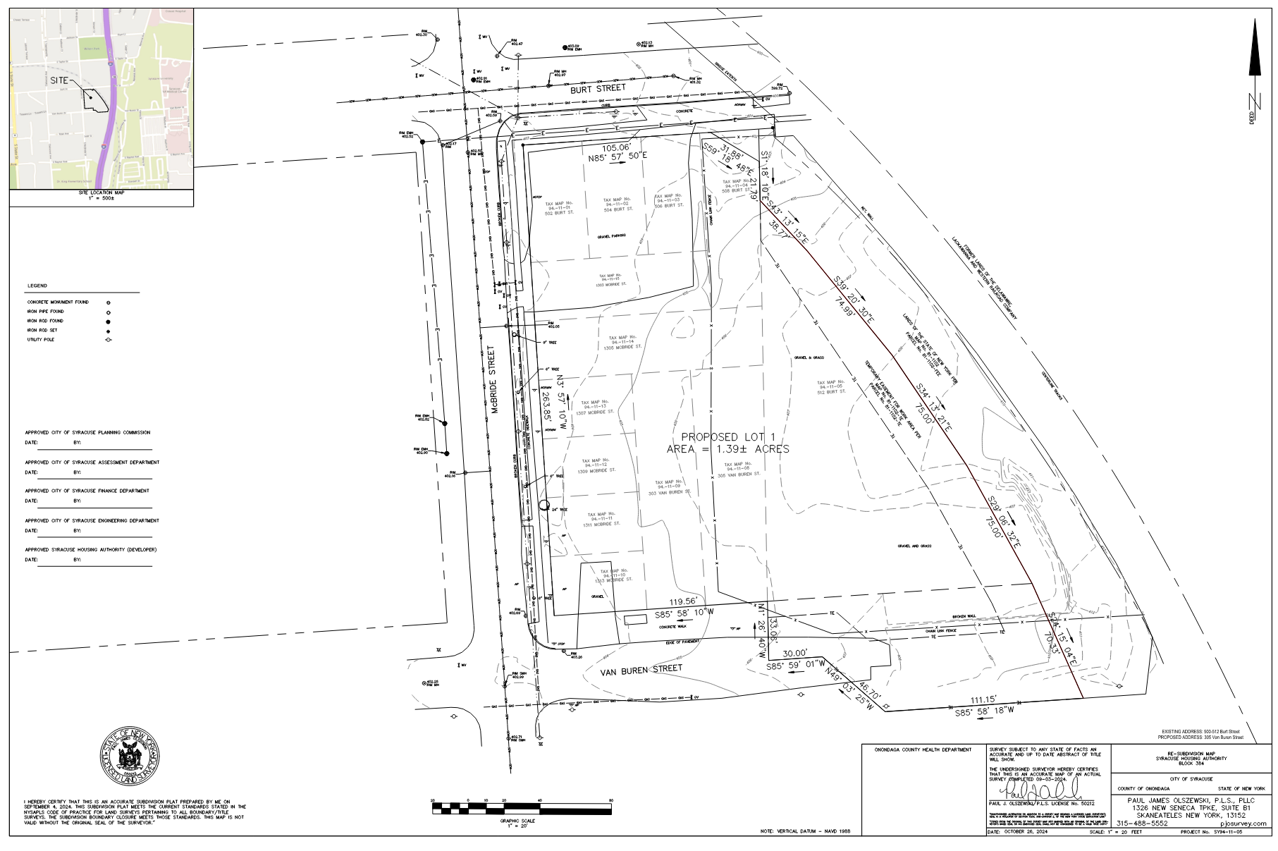
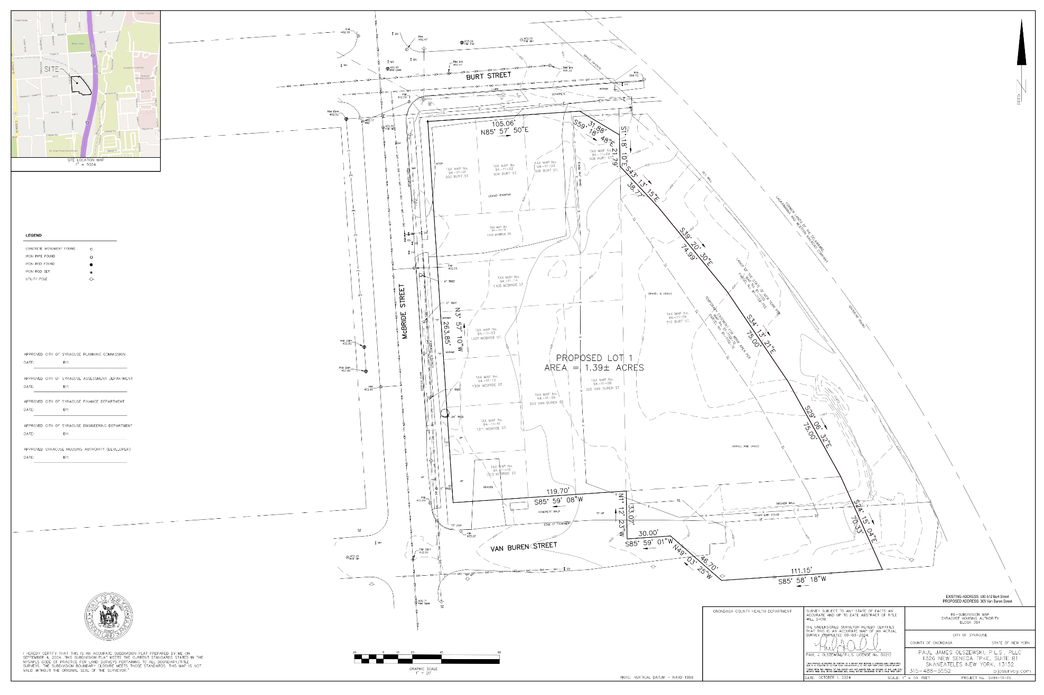
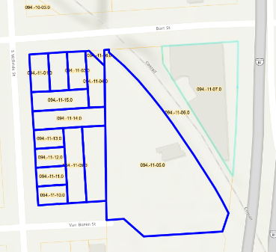
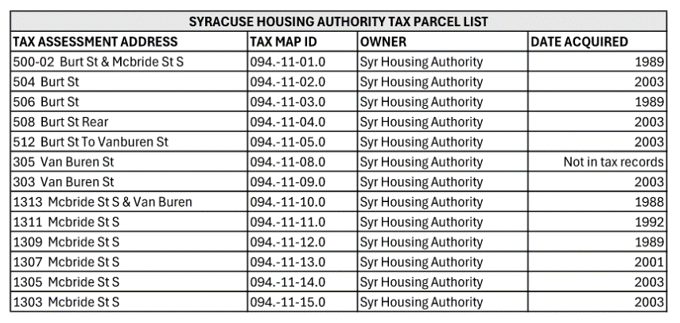
SYRACUSE HOUSING AUTHORITY
NEW CENTRAL OFFICES
RESUBDIVISION MAP:
Proposal: Combine 13 lots into one
Existing Parcels Map
Current Land Use: Vacant Land

Slide 5
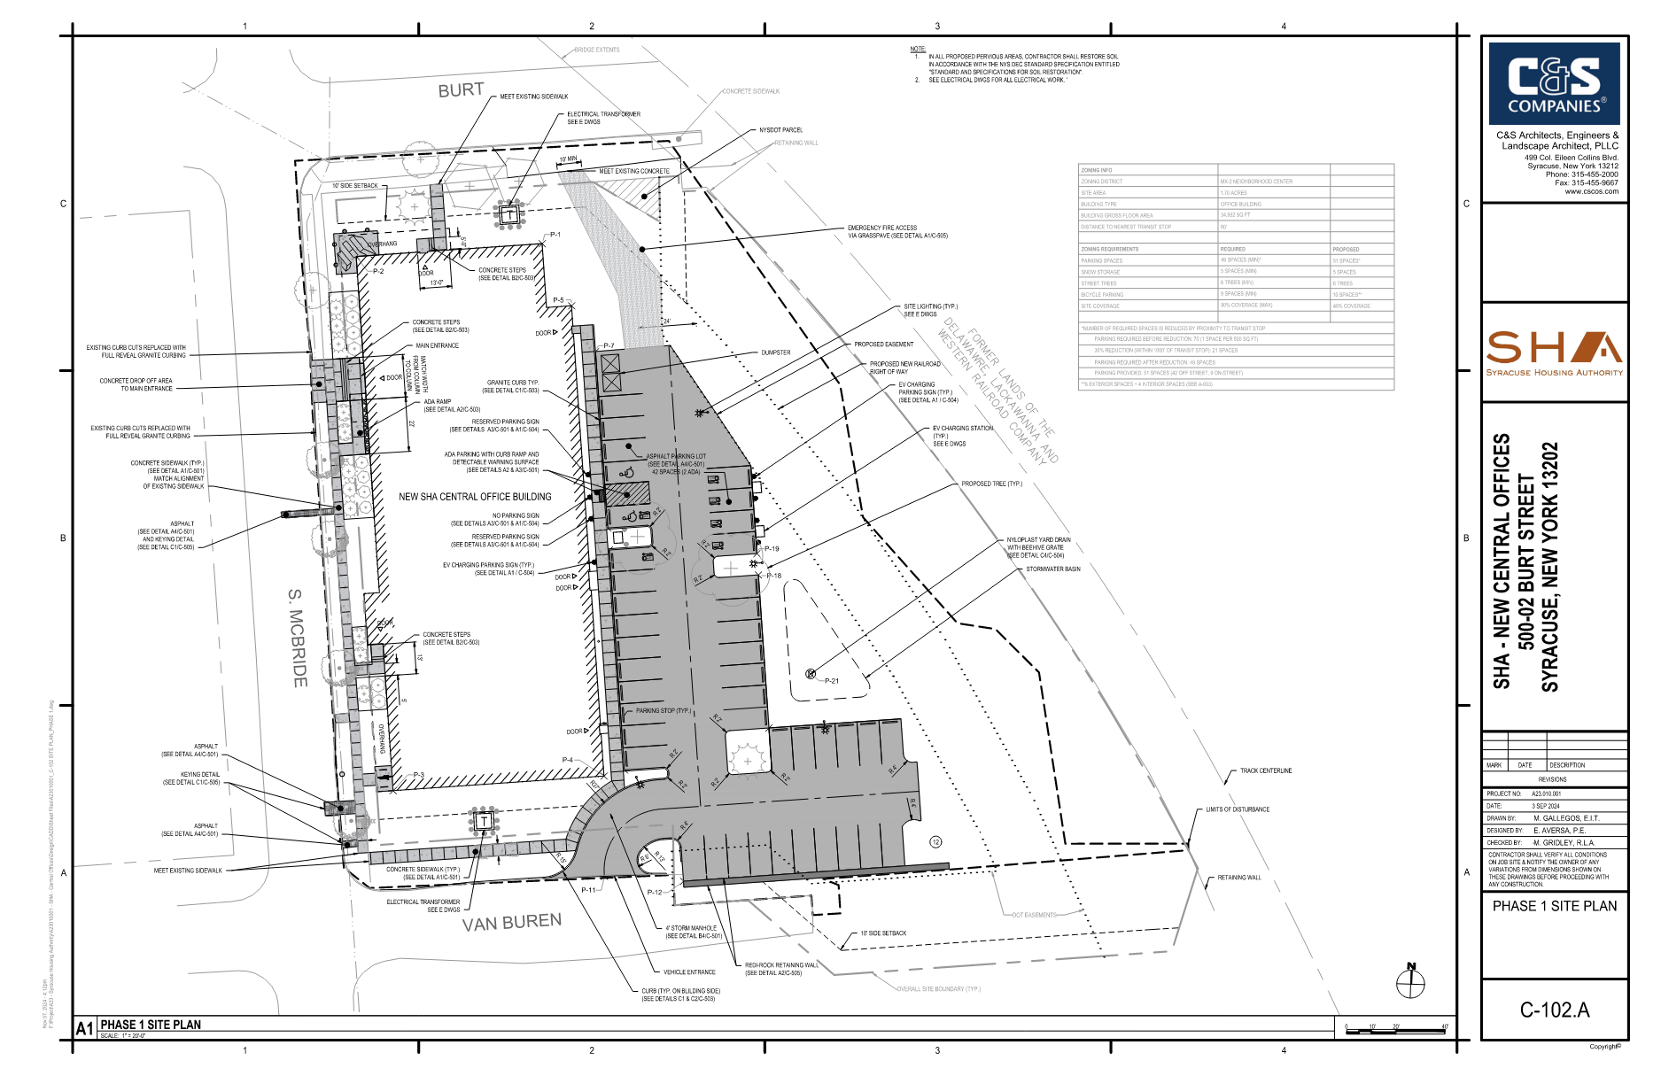
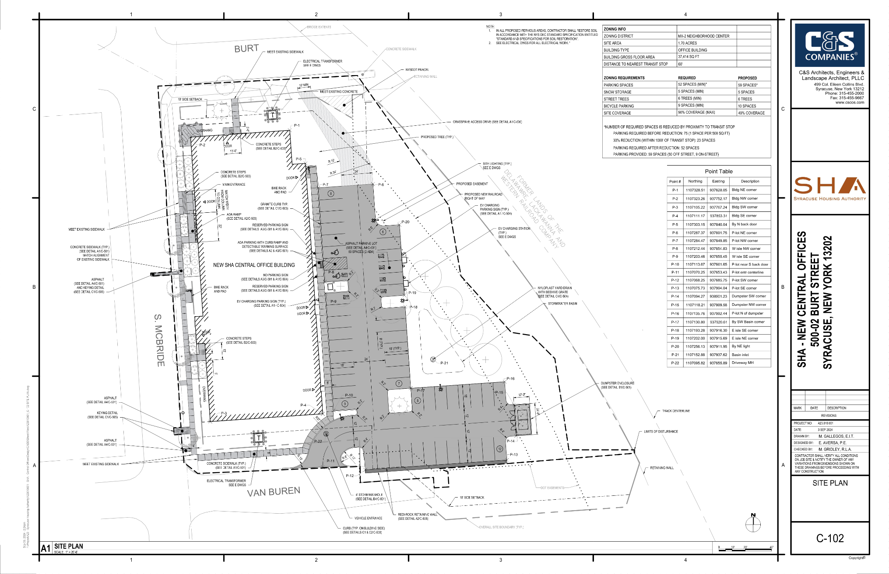
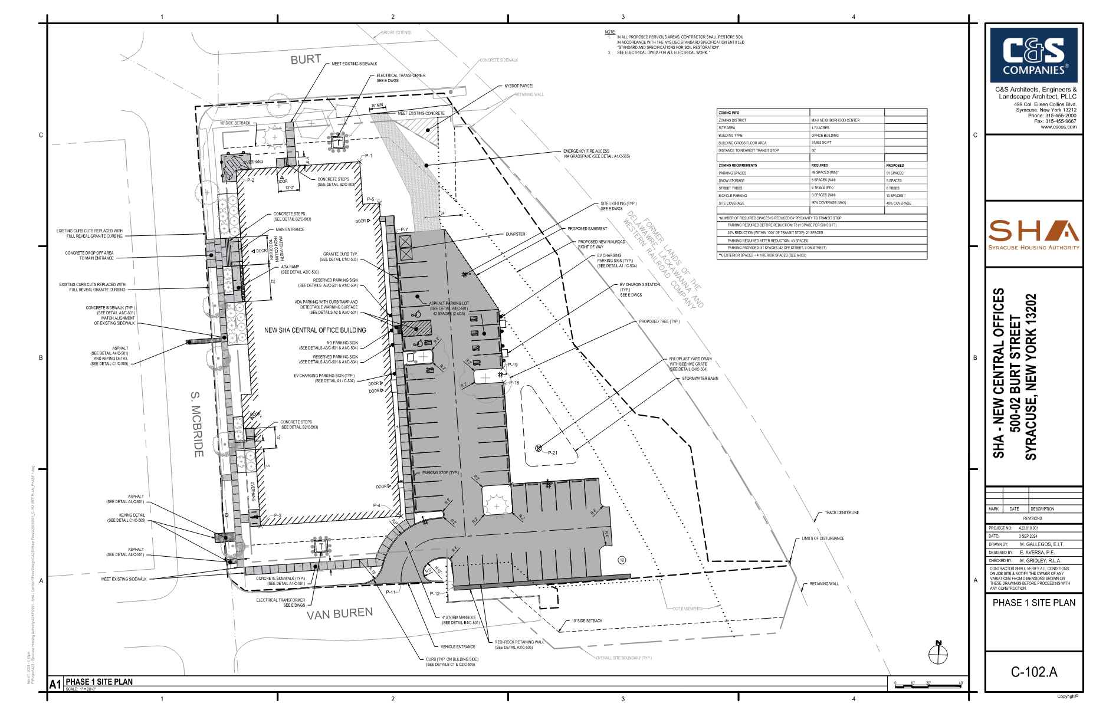
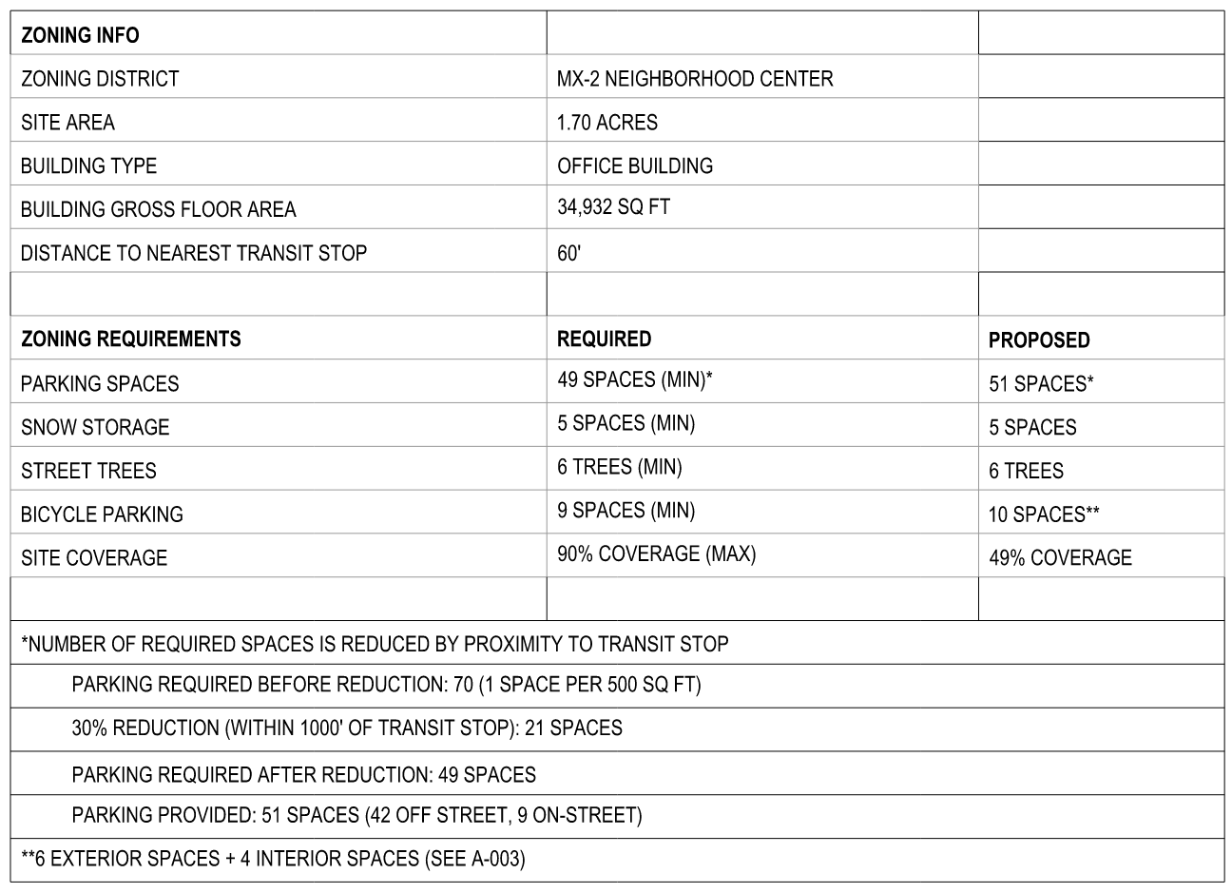
SYRACUSE HOUSING AUTHORITY
NEW CENTRAL OFFICES
PHASE 1 SITE PLAN:
New building, parking lot, landscaping

Slide 6

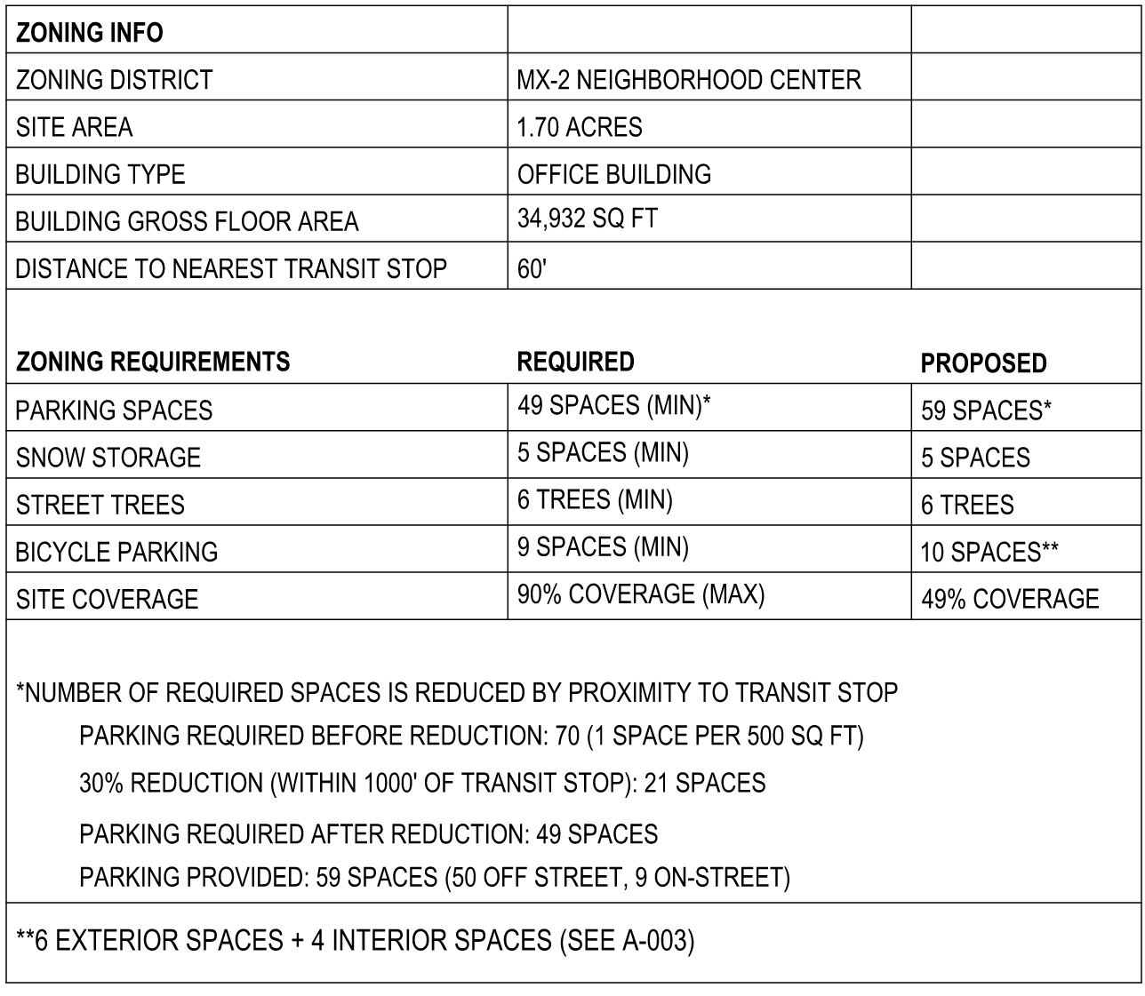
SYRACUSE HOUSING AUTHORITY
NEW CENTRAL OFFICES
PHASE 2 SITE PLAN:
New building, parking lot, landscaping

Slide 7
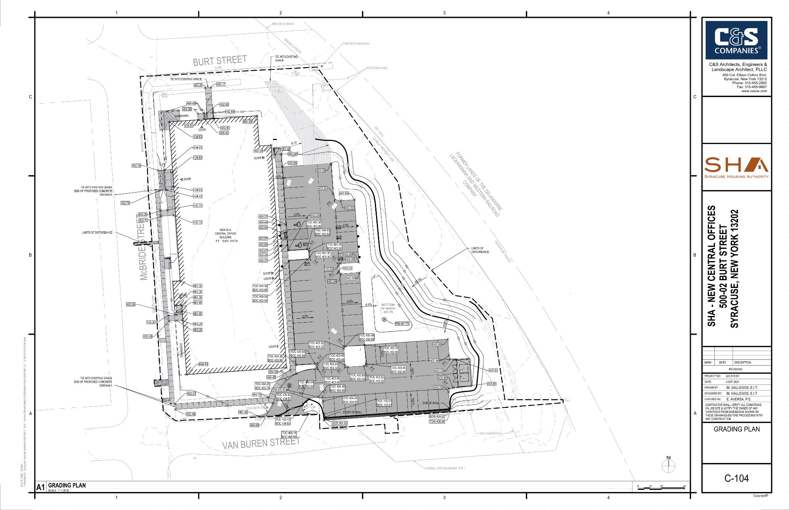
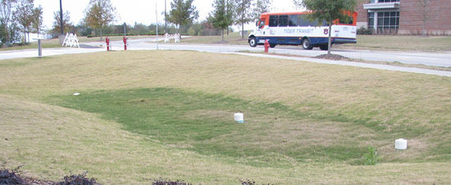
SYRACUSE HOUSING AUTHORITY
NEW CENTRAL OFFICES
GRADING PLAN:
Impervious area decreased by 25%—additional treatment not required.
Sheet flow to bioretention basin:
IMAGE SOURCE: MSU
Tie in to DOT grading in progress
Notes:
In accordance with the NYSDEC stormwater design criteria for redevelopment projects, if a project decreases the amount of impervious area on a site by 25% or more, water quality treatment requirements are satisfied (New York State Stormwater Design Manual [NYSDM], Section 9.2.1). Therefore, no additional water quality practices are required for this project.
Though not required for water quality treatment or water quantity attenuation purposes, a bioretention basin has been provided at the north site of the site to provide an enhanced collection and treatment area for roof and parking lot runoff.

Slide 8
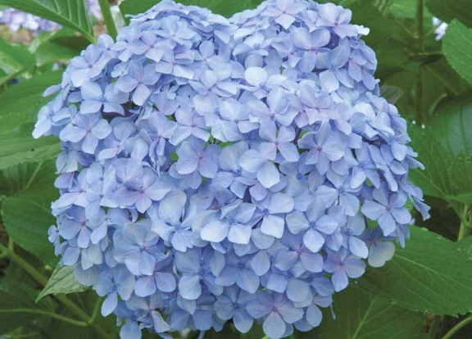
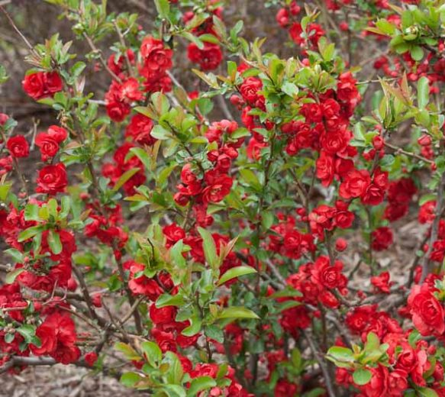
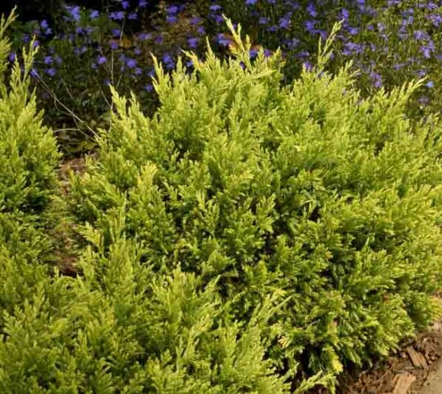
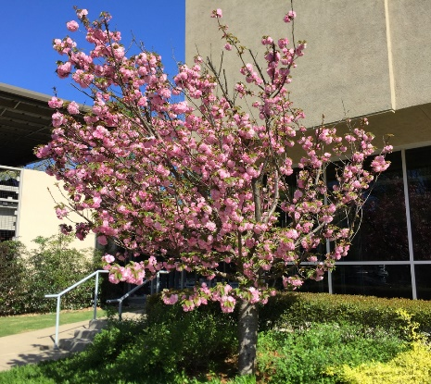
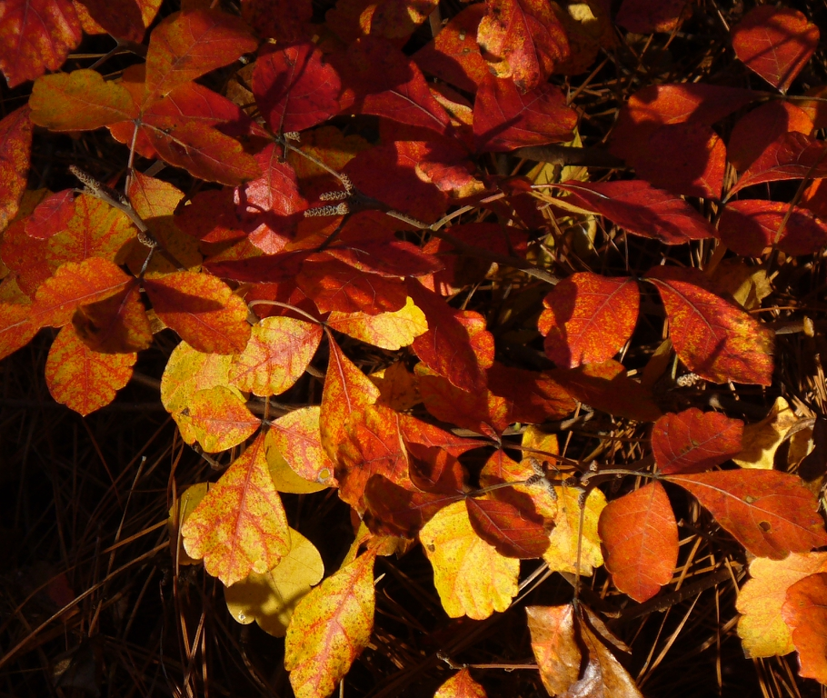
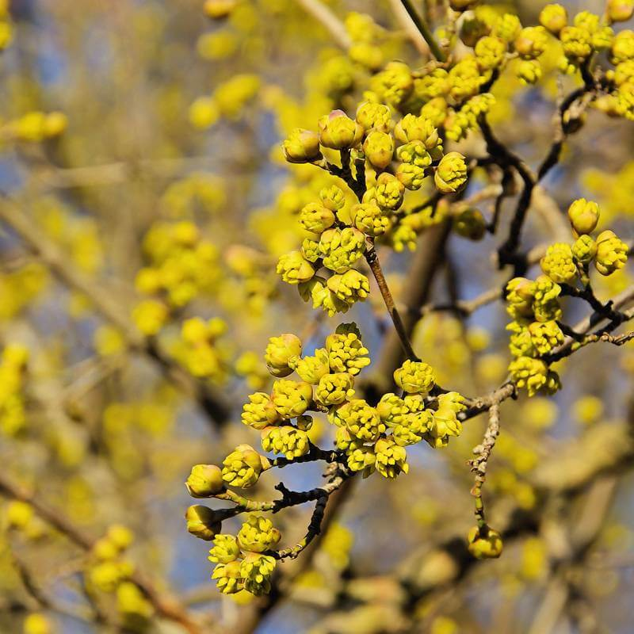
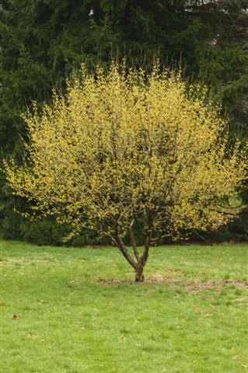
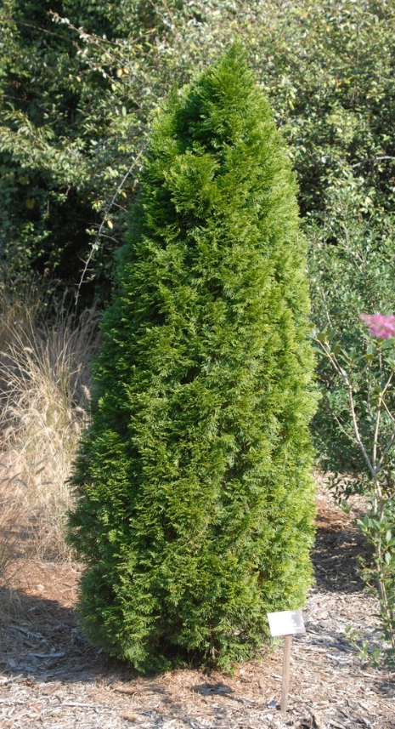
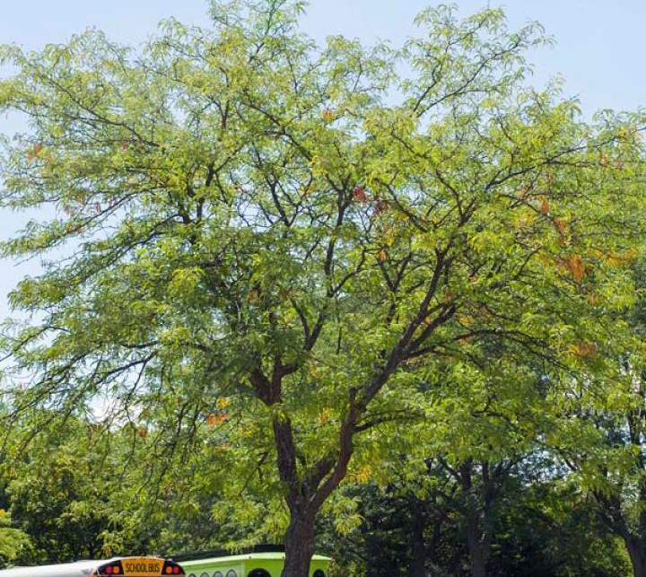
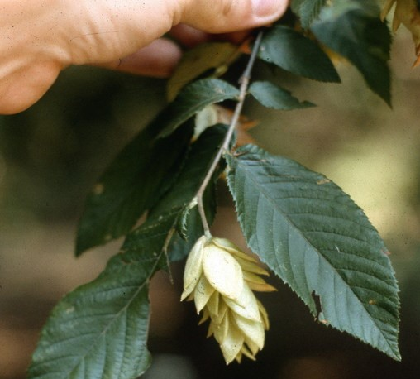
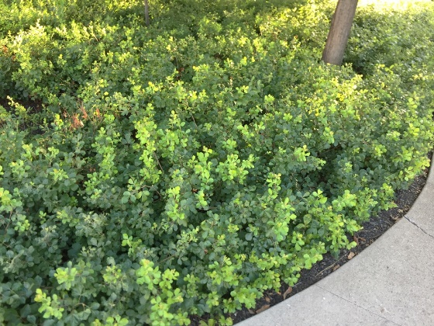
SYRACUSE HOUSING AUTHORITY
NEW CENTRAL OFFICES
IMAGE SOURCES: GARDENIA AND NCSU
Notes:
Plant palette of native and/or adapted plant species that are regionally appropriate
Establishing an attractive streetscape that contributes to the character and appearance of the City and creates a safe and pleasant environment for people
Cornus mas `Golden Glory` / Golden Glory Cornelian Cherry
Gleditsia triacanthos inermis `Skyline` / Skyline Honey Locust
Ostrya virginiana / American Hophornbeam
Prunus serrulata / Japanese Flowering Cherry
Thuja occidentalis / American Arborvitae
Chaenomeles speciosa 'Scarlet Storm' / Double Take® Scarlet Storm Flowering Quince
Hydrangea macrophylla 'Big Daddy' / Big Daddy Hydrangea
Juniperus horizontalis 'Hegedus' / Good Vibrations® Gold Juniper
Rhus aromatica 'Gro-Low' / Gro-Low Fragrant Sumac

Slide 9
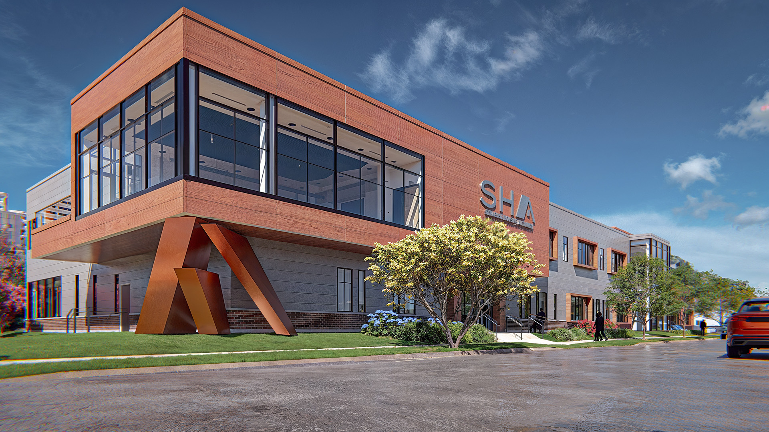
SYRACUSE HOUSING AUTHORITY
NEW CENTRAL OFFICES
RENDERING:
Building Exterior

Slide 10
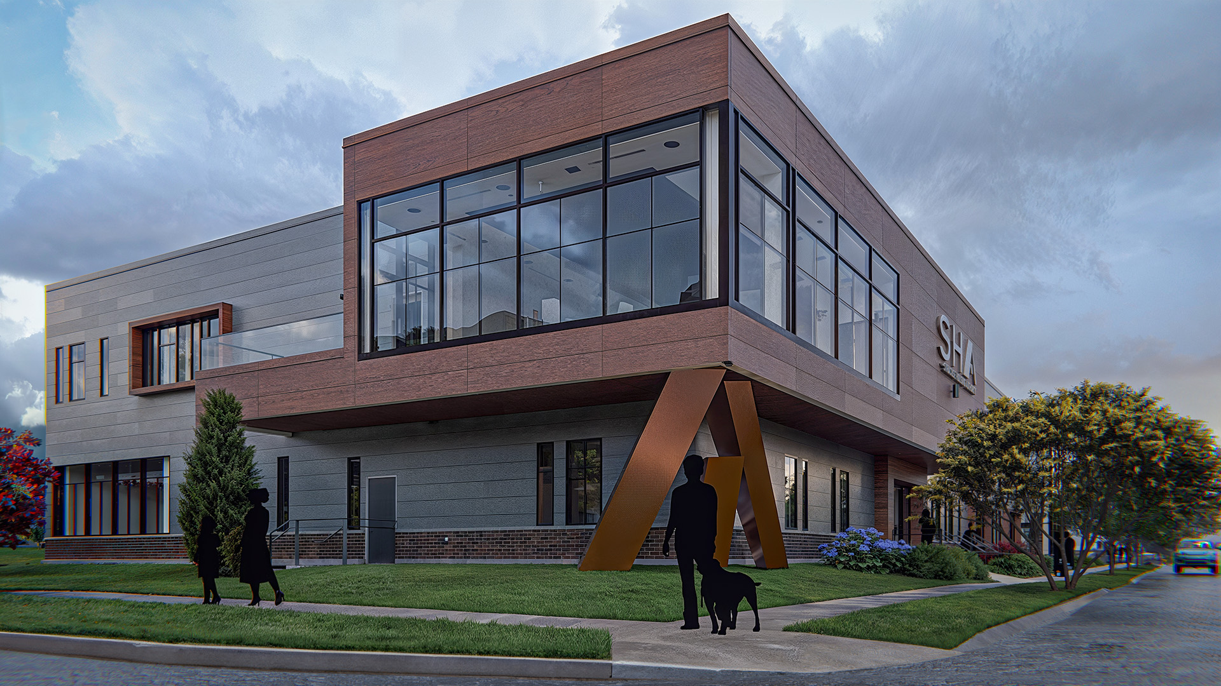
SYRACUSE HOUSING AUTHORITY
NEW CENTRAL OFFICES
RENDERING:
Building Exterior

Slide 11
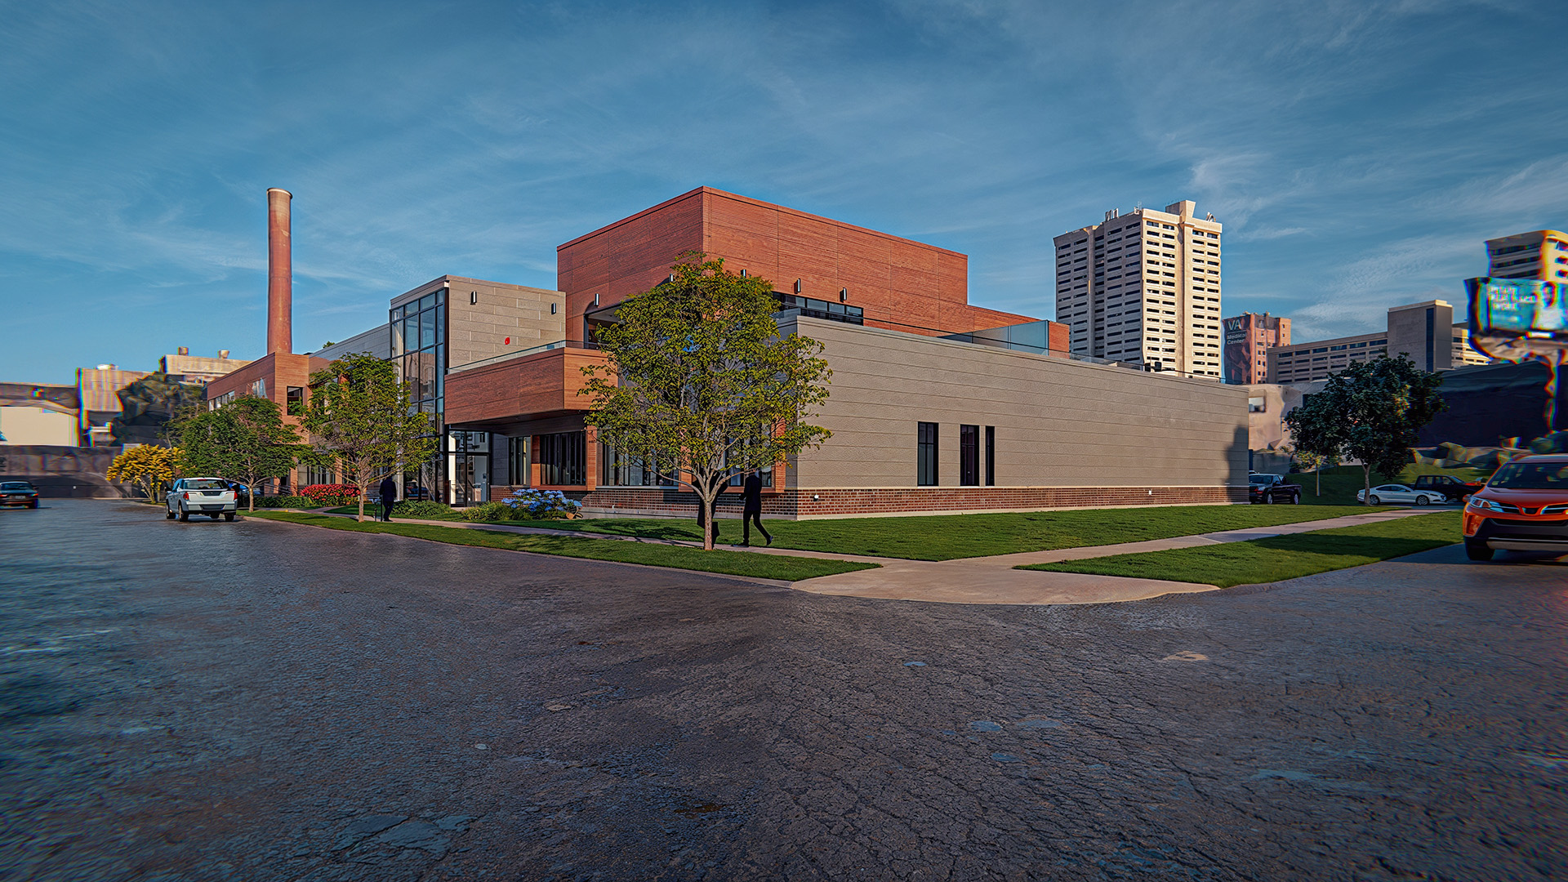
SYRACUSE HOUSING AUTHORITY
NEW CENTRAL OFFICES
RENDERING:
Building Exterior

Slide 12
SYRACUSE HOUSING AUTHORITY
NEW CENTRAL OFFICES
THANK YOU

