Slide 1
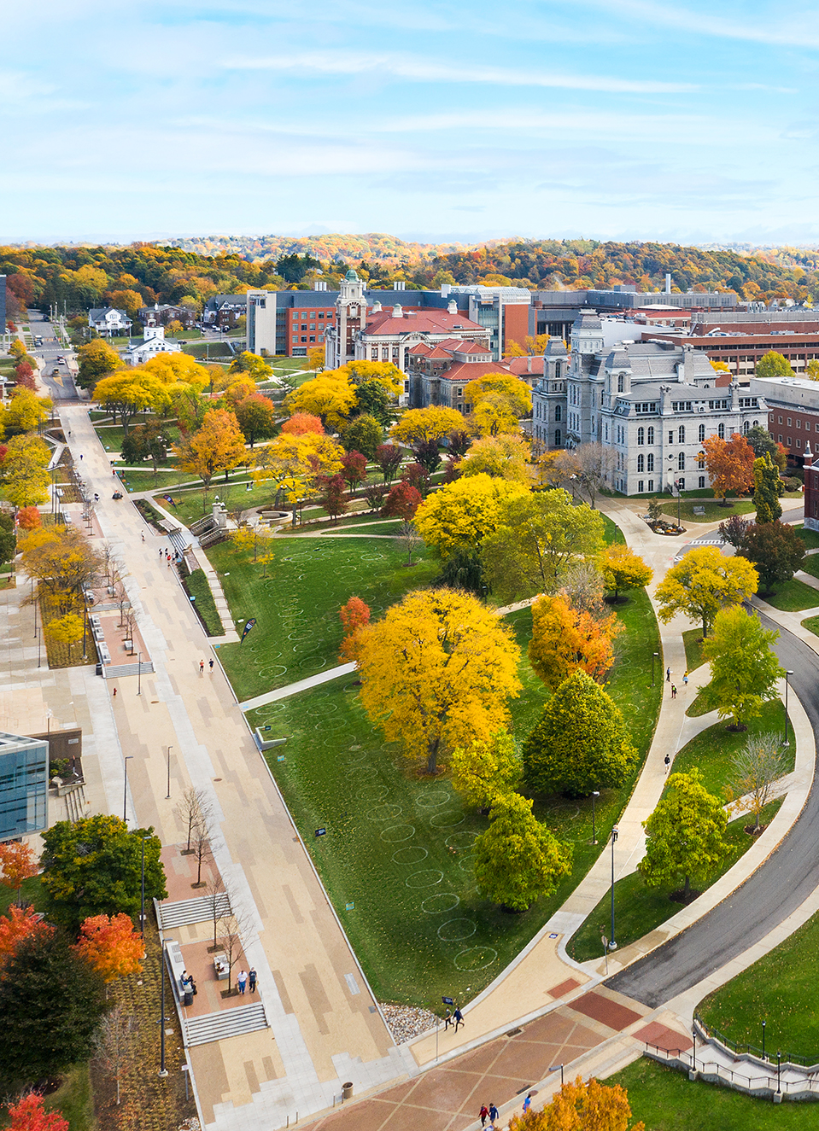

New Student Housing
Planning Commission
September 9, 2024

Slide 2
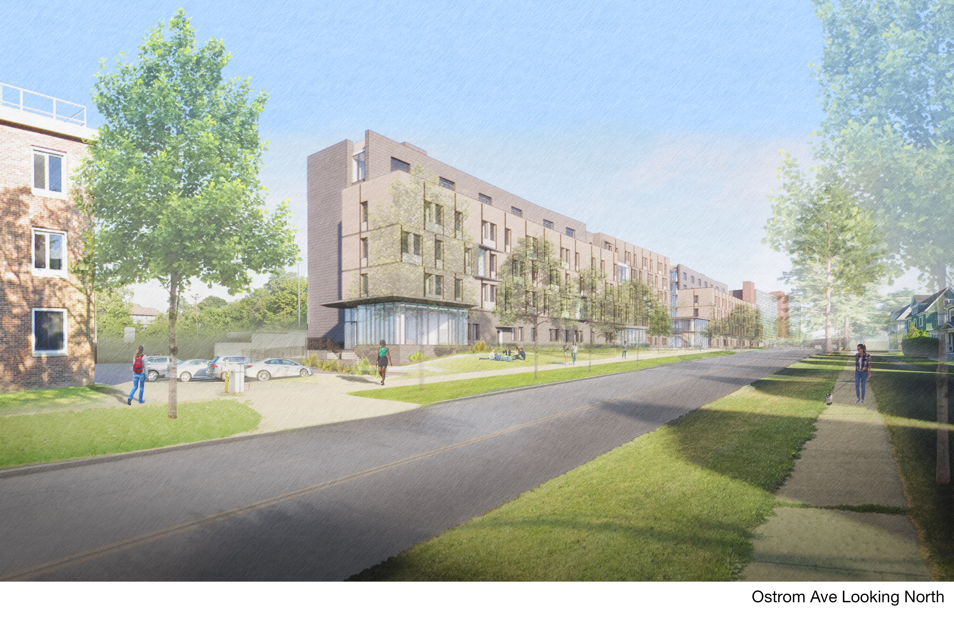

Slide 3
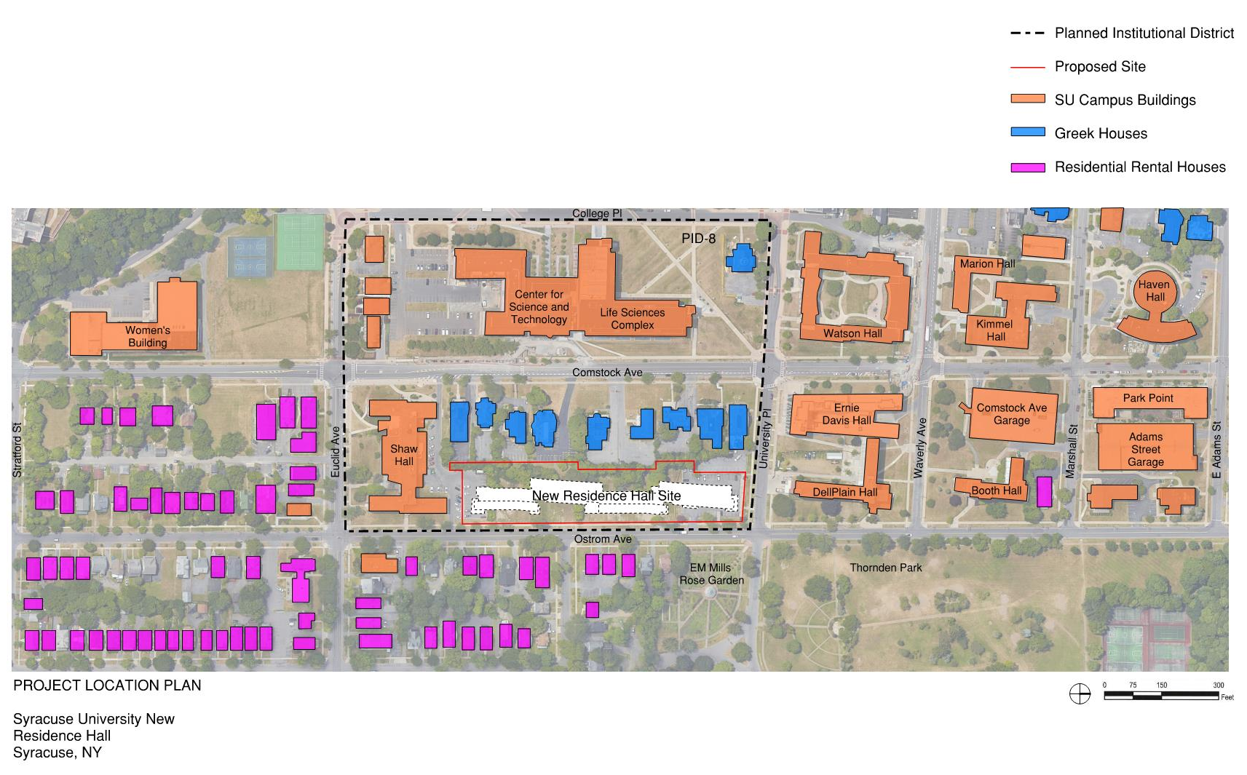
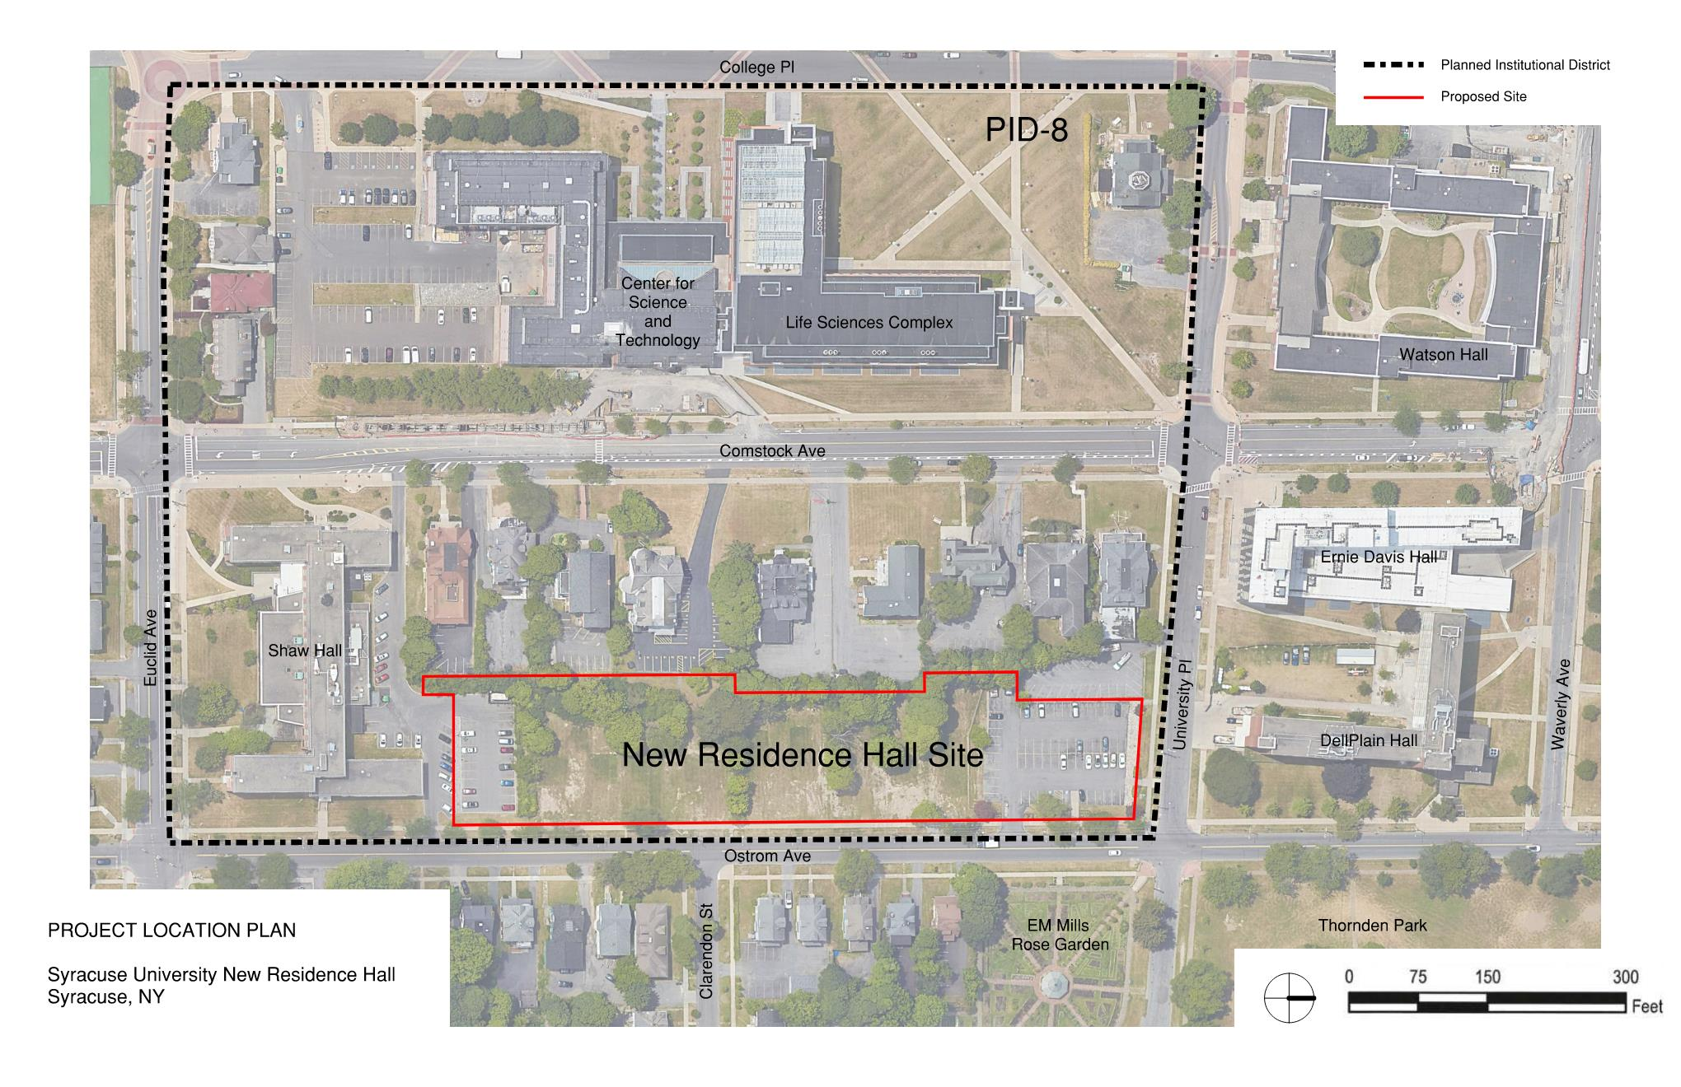
Neighborhood Character

Slide 5
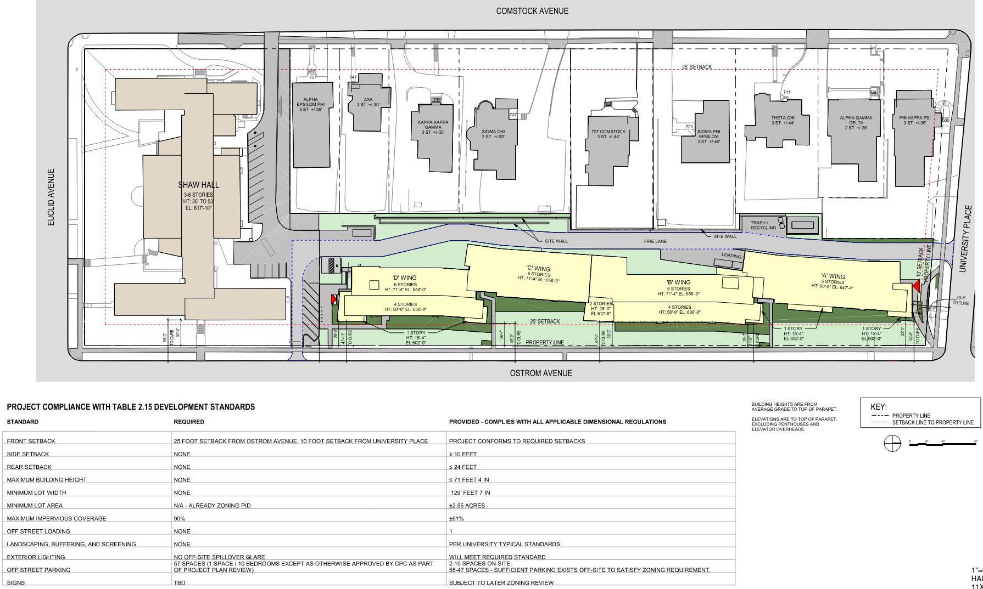
Site Plan

Slide 6
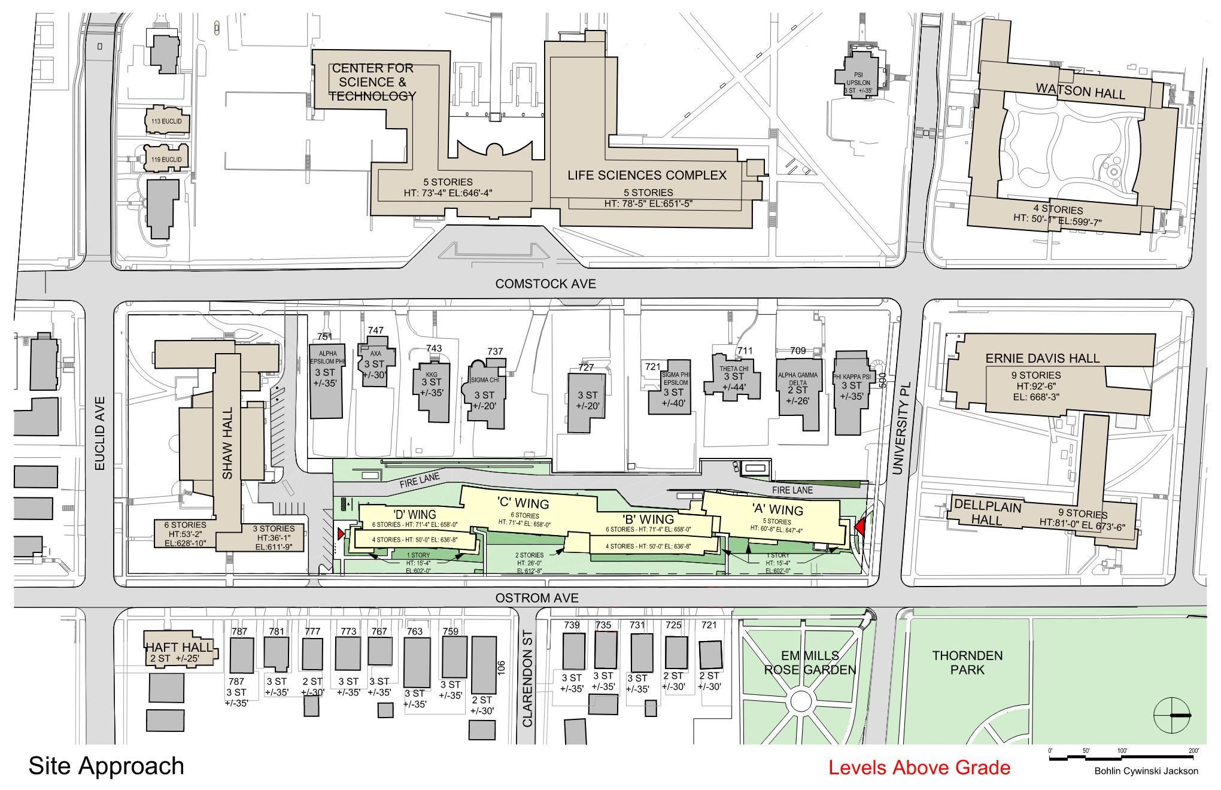
Site Plan | Building Height

Slide 7
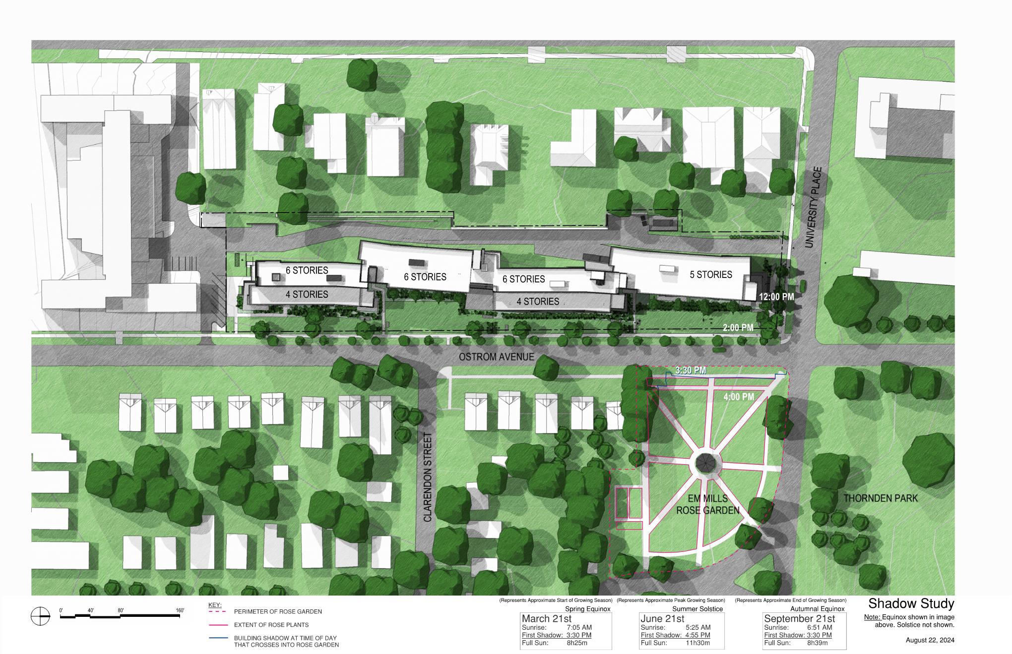
Shadow Study

Slide 8
THANK YOU!

