Slide 1
Surveillance Technology Working Group
Meeting #51
8/08/2023

Slide 2
Agenda
Body Worn Camera
    - Recap of Corte Madera Presentation
    - Review of progress on Body Worn Camera Questions
    - Overview of Draft Guidelines
  Coming Up
Questions

Slide 3
Reference Slides

Slide 4
Review
Past Decisions
Fotokite: Aerial UAS allowing for different perspectives during crisis response. Not exempt, will go through the process.
  Press Release out, done with public comment period
  Public comments received, received comments from SPD
  Recommendation was sent to the Mayor
Vacant Lot Monitoring: Sensor that detect changes in a scene to monitor lots for dumping. Not exempt, will go through the process.
  Press Release out, done with public comment period
  Public comments received, waiting for updated data from the requesting department
Community Asset Tracker: Camera with machine learning algorithm to identify objects within the city.
  Assessed pilot, documentation provided
COPS: Cameras strategically placed around the city to aid in policing
  Exempted

Slide 5
Review
Past Decisions
Samsara: Fleet management technology
  Assessed in previous session
  Public comment period completed
  Recommendation was sent to the Mayor on 2/01
  Mayor Walsh stated that he read the read the groups recommendations, and is in agreement with a qualified approval, and is in agreement with the importance of putting in appropriate policies and procedures.
Flock Safety/ALPRs: Street cameras that capture vehicle plates.
  Assessed in previous session
  Public comment period completed
  The Work Group heard from SPD Officers on 1/25/22 for more information regarding this.
  The STWG created guidelines for ALPR Use and this was recommended to the mayor with the stipulations written on 3/11/22.

Slide 6
Review
Past Decisions
Cyclomedia: Right of Way Imaging
  Public comment period completed
  Recommendation was sent to the Mayor on 5/07/22
  Mayor Walsh stated: I have reviewed the STWG’s recommendation and I am in agreement with it.
Dataminr: Social Media monitoring of violent posts.
  Dataminr staff met with STWG on 6/21/2022.
  Dataminr then removed their offer of service on 6/21/2022.
Rubicon: Vehicle route optimization software
  STWG met on 9/27/22 and this was determined to not be a form of Surveillance
Opticom: Software that in an event of an emergency the Fire Department could switch the traffic lights on their route to turn green for them.
  STWG met on 12/06/22 and this was determined to not be a form of Surveillance

Slide 7
Review
Internal Norms
Attendance:
If members have unjustified absences for three meetings in a three month time period, the Surveillance Team Working Group (STWG) Coordinators will reach out to the member.
The working group is required to have at least 50% of all members present before we hold a recommendation vote.
  Of those present at least 40% should be non-city staff.
External Participants:
Outside participants should request permission before-hand to the API team.
  The API team will inform the STWG before meetings if there will be outside participants joining the group.
Documentation for Community Review:
The notes from the STWG Sessions will be posted to the STWG Website after the meetings.
Letter of Commitment:
Is effective for one year, and is to be sent out annually.
View Attendance and Guest Norms

Slide 8
Review
Service Level Agreements (SLAs)
2 - 6 Weeks
(10 - 30
Business Days)
Every 2 Weeks
(10 Business Days)
2 Weeks
(10 Business Days)
2 Weeks
(10 Business Days)
Initial submission to determination of surveillance
Short duration meeting to vote on technology exemptions
Public comment period:
Issuance of press release
Council meeting
(*) For now public input will be received via a Google Form and in the future will be on the new website.
Submission of finalized form (by dept.) to time of recommendation.
Group will individually research; departments will get follow-up questions; group to vote yes/no; and submit recommendation.

Slide 9
STWG Long Term Plan (Review)
Update STWG Website
Tech Recommendations
Meeting Notes and Slide Decks
Connect with other cities doing surv. tech work
Revamp our approach to community engagement
Complete Citywide departmental training
Determine Schedule for refresher trainings (annually or every 6 months)
Complete an audit of technologies currently used by the City as Surveillance or Not
Release an Annual Report
Including recommendations, data that came from recommendations, and if stipulations are being followed.
Short Term
(April – June 2022)
Medium Term
(July – September 2022)
Long term
(October – December 2022)

Slide 10
STWG Long Term Plan (Review)
Begin process of trying to transfer STWG to a City Ordinance
Determine Member’s Term Duration
Requires more planning

Slide 11
Technology Audit Roadmap (Review)
Review List of technology (Make initial determination if “Not Surveillance” or “Need more information”)
For flagged technologies, send Technology Audit Form requesting more info.
When information is received, group votes on whether identified technology will be characterized as surveillance.
Go through same process as Digital Services
In addition, try to schedule a site visit to be able to find more information about how technologies are used.
Go through same process as Digital Services and Fire Dept.
In addition, try to schedule a site visit to be able to find more information about how technologies are used.
Digital Services
Fire Department
Syracuse Police Dept

Slide 12
Definition
Definition of a Surveillance Technology (According to Mayor’s Executive Order on Surveillance Technology):
Technologies that “observe or analyze the movements, behavior, or actions of identifiable individuals in a manner that is reasonably likely to raise concerns about civil liberties, freedom of speech or association, racial equity or social justice.”

Slide 13
Technology Audit
Digital Services provided a list of City Software used
  List can be viewed HERE
Chief Gleeson provided the list of technology from the Fire Department
  He also completed the survey assessment for this technology.
  Results can be viewed HERE.
List of technology provided from the Syracuse Police Department are:
  Documentation can be viewed HERE.
List of technology provided from Strategic Initiatives / Internet of things
  Documentation can be viewed HERE

Slide 14
Meeting slides

Slide 15
Body Worn Cameras

Slide 16
Body Worn Cameras (Codes)
Applicant name: Code Enforcement Company: United Radio (tentative) Sponsoring Department: Code Enforcement | Application Date: 4/12/23 Partner Organization/Technologies: United Radio (tentative) | Proof of Concept Demonstration? Technology Implementation? Exempt?
Technology Purpose: To outfit Code Enforcement Officers with Body Worn cameras. This would assist with keeping inspectors safe while out in the field and allows Codes Department another means to document inspection activity. |  | Operation/Implementation description: This technology would be used internally by Code Enforcement, would be used for internal documentation purposes only. Codes Enforcement would like to follow similar policies for standards and policies that SPD uses for ther officer worn cameras.
Data Management Plan: TBD Cloud vs on prem: TBD | Intended Operation: These Cody Cameras would be worn by Code Enforcement inspectors when they are responding to housing inspections. These would document incident/safety concerns and as evidence for inspections. | Maintainability/Scalability/Reliability/Vulnerabilities: Unknown Cybersecurity Plan: Unknown Broader Impacts/Unintended Consequences/Concerns: Unknown | Who is the audience for this system?: The info or video collected is only for code officers use as official government agents. How many units/how is the system deployed?: TBD Volume, size and type of data: Images, size TBD Length of time application is expected to be used: Indefinitely
X
  *Full form responses can be viewed HERE

Slide 17
Town of Corte Madera, CA
        Recap:
        Adam Wiley, Code Enforcement Official, reported that their main use of the cameras were to protect the inspectors against accusations.
        Had different guidelines for recording in a public place as opposed to a home
        Would have the camera on when they approached the home, would ask for permission to record, if this was denied, they turn off their camera, and continue the inspection as normal.
        Any comments/thoughts?

Slide 18
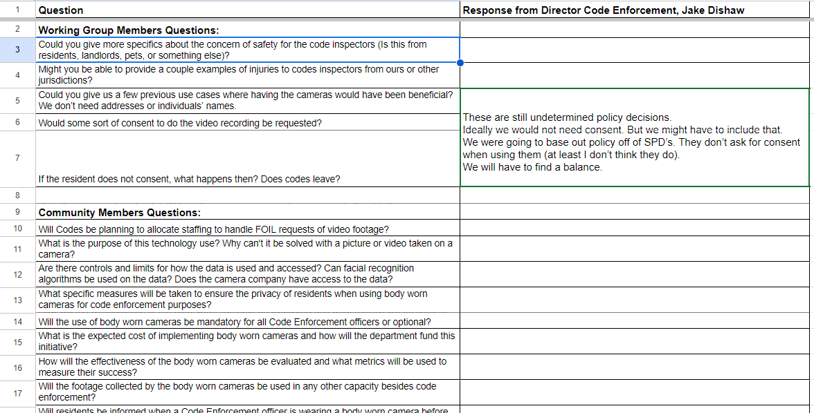
Body Worn Camera – Questions Raised
  Following questions have been identified. Link to view full sheet is here.

Slide 19
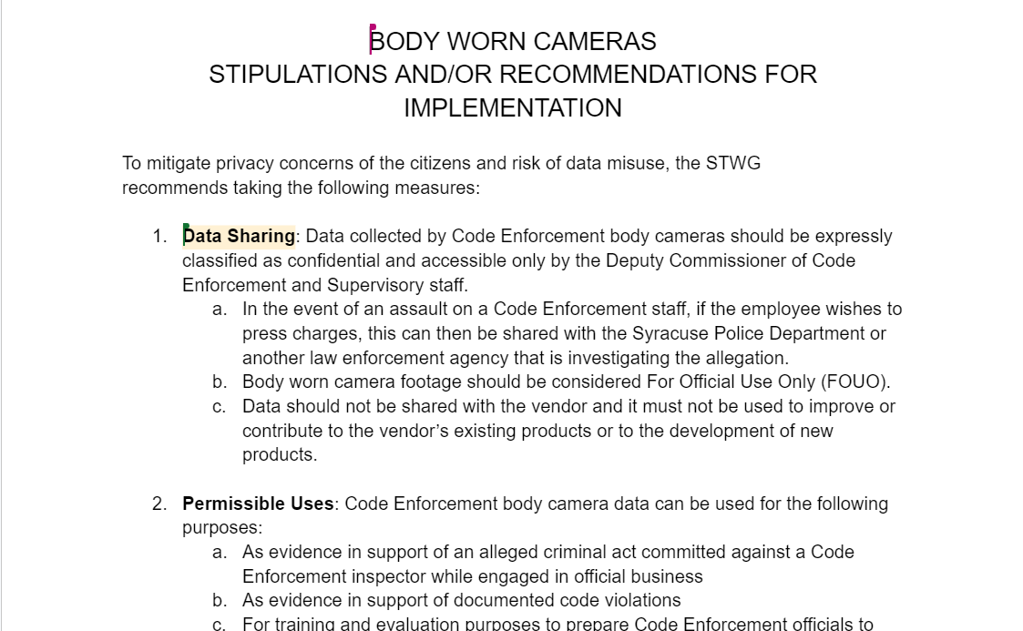
Body Worn Camera – Draft Guidelines
  Draft Guidelines were started (thanks again to Jen and Bradford! 🙌)
  Link is HERE

Slide 20
Coming Up
Citywide Technology Audit: Continue to integrate the work done on various sections
                Review sessions with department heads
                Provide feedback
                Final draft

Slide 21
Questions
?

Slide 22
Vacant Lot Monitoring (DPW)
Applicant name: DPW Company: Cimcom (Purchased by Quantela) Sponsoring Department: DPW | Application Date: 6/08/2021 Partner Organization/Technologies: Cimcom (Purchased by Quantela) | Proof of Concept Demonstration? Technology Implementation? Exempt?
Technology Purpose: Sensor that detect changes in a scene to monitor lots for dumping. It uses a camera mounted on a street light or utility pole to monitor City-owned vacant lots where illegal dumping is a recurring problem. |  | Operation/Implementation description: The images are edge-processed at the pole utilizing a street light mounted processing device. The edge processor compares current and former images to determine if objects have been left behind. When it detects a dumping event, it sends a text message notification to designated DPW staff. It could potentially be used to obtain images of the illegal dumping events as well.
Data Management Plan: TBD Cloud vs on prem: TBD | Intended Operation: This technology helps DPW to more efficiently pick up trash. | Maintainability/Scalability/Reliability/Vulnerabilities: Unknown Cybersecurity Plan: Unknown Broader Impacts/Unintended Consequences/Concerns: Unknown | Who is the audience for this system?: DPW may decide to share data with Syracuse Police if the images appear to capture a criminal act. How many units/how is the system deployed?: TBD Volume, size and type of data: Images, size TBD Length of time application is expected to be used: Indefinitely
X
  *Full form responses can be viewed HERE

Slide 23
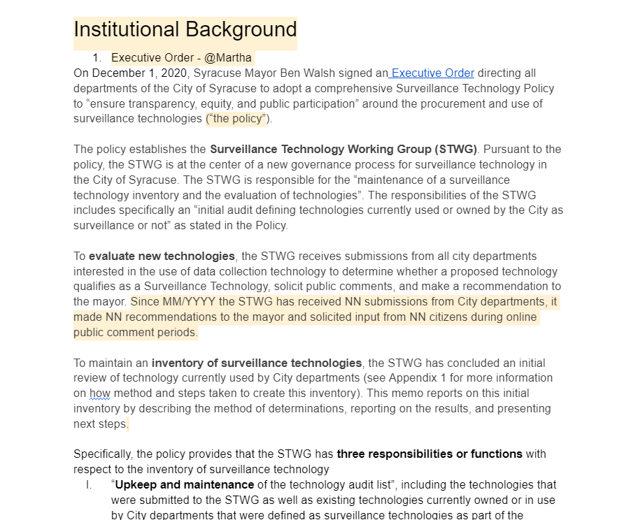
City Wide Technology Audit
The template that we put together so far can be viewed here:
Review updates on different sections

Slide 24
Votes
STWG Member | Vote in Favor | Vote in Favor w/Stipulations | Vote Against | Abstention | Absence
Nico Diaz
Chief Tim Gleeson
Martha Grabowski
Johannes Himmelreich
Ocesa Keaton
Mark King
Timothy Liles
Dep. Mayor Sharon Owens

Slide 25
Votes
STWG Member | Vote in Favor | Vote in Favor w/Stipulations | Vote Against | Abstention | Absence
Jawwaad Rasheed
Jason Scharf
Daniel Schwarz
Michelle Sczpanski
1st DC Richard Shoff
Jen Tifft
Valerie Didamo

