Slide 1
Surveillance Technology Working Group
Meeting #55
11/28/2023

Slide 2
Agenda
Automated Speed & Redlight Enforcement Technologies
Status of the Citywide Audit & Inventory
Destiny USA ALPR's
  Coming Up
Questions

Slide 3
Reference Slides

Slide 4
Review
Past Decisions
Fotokite: Aerial UAS allowing for different perspectives during crisis response. Not exempt, will go through the process.
  Press Release out, done with public comment period
  Public comments received, received comments from SPD
  Recommendation was sent to the Mayor
Vacant Lot Monitoring: Sensor that detect changes in a scene to monitor lots for dumping. Not exempt, will go through the process.
  Press Release out, done with public comment period
  Grandfathered in because the request was made before review process
Community Asset Tracker: Camera with machine learning algorithm to identify objects within the city.
  Assessed pilot, documentation provided
COPS: Cameras strategically placed around the city to aid in policing
  Exempted

Slide 5
Review
Past Decisions
Samsara: Fleet management technology
  Assessed in previous session
  Public comment period completed
  Recommendation was sent to the Mayor on 2/01
  Mayor Walsh stated that he read the read the groups recommendations, and is in agreement with a qualified approval, and is in agreement with the importance of putting in appropriate policies and procedures.
Flock Safety/ALPRs: Street cameras that capture vehicle plates.
  Assessed in previous session
  Public comment period completed
  The Work Group heard from SPD Officers on 1/25/22 for more information regarding this.
  The STWG created guidelines for ALPR Use and this was recommended to the mayor with the stipulations written on 3/11/22.

Slide 6
Review
Past Decisions
Cyclomedia: Right of Way Imaging
  Public comment period completed
  Recommendation was sent to the Mayor on 5/07/22
  Mayor Walsh stated: I have reviewed the STWG’s recommendation and I am in agreement with it.
Dataminr: Social Media monitoring of violent posts.
  Dataminr staff met with STWG on 6/21/2022.
  Dataminr then removed their offer of service on 6/21/2022.
Rubicon: Vehicle route optimization software
  STWG met on 9/27/22 and this was determined to not be a form of Surveillance
Opticom: Software that in an event of an emergency the Fire Department could switch the traffic lights on their route to turn green for them.
  STWG met on 12/06/22 and this was determined to not be a form of Surveillance

Slide 7
Review
Past Decisions
Body-Worn Camera's (Code Enforcement):
  Recommendation was sent to the Mayor in Sept. 2023
  Mayor Walsh signed a letter stating that he is in agreement wiht the groups determination.

Slide 8
Review
Internal Norms
Attendance:
If members have unjustified absences for three meetings in a three month time period, the Surveillance Team Working Group (STWG) Coordinators will reach out to the member.
The working group is required to have at least 50% of all members present before we hold a recommendation vote.
  Of those present at least 40% should be non-city staff.
External Participants:
Outside participants should request permission before-hand to the API team.
  The API team will inform the STWG before meetings if there will be outside participants joining the group.
Documentation for Community Review:
The notes from the STWG Sessions will be posted to the STWG Website after the meetings.
Letter of Commitment:
Is effective for one year, and is to be sent out annually.
View Attendance and Guest Norms

Slide 9
Review
Service Level Agreements (SLAs)
2 - 6 Weeks
(10 - 30
Business Days)
Every 2 Weeks
(10 Business Days)
2 Weeks
(10 Business Days)
2 Weeks
(10 Business Days)
Initial submission to determination of surveillance
Short duration meeting to vote on technology exemptions
Public comment period:
Issuance of press release
Council meeting
(*) For now public input will be received via a Google Form and in the future will be on the new website.
Submission of finalized form (by dept.) to time of recommendation.
Group will individually research; departments will get follow-up questions; group to vote yes/no; and submit recommendation.

Slide 10
STWG Long Term Plan (Review)
Update STWG Website
Tech Recommendations
Meeting Notes and Slide Decks
Connect with other cities doing Surv. Tech Work
Revamp our approach to community engagement
Complete Citywide departmental training
Determine Schedule for refresher trainings (annually or every 6 months)
Complete an audit of technologies currently used by the City as Surveillance or Not
Release an Annual Report
Including recommendations, data that came from recommendations, and if stipulations are being followed.
Short Term
(April – June 2022)
Medium Term
(July – September 2022)
Long term
(October 2022 – December 2023)

Slide 11
STWG Long Term Plan (Review)
Begin process of trying to transfer STWG to a City Ordinance
Determine Member’s Term Duration
Requires more planning

Slide 12
Technology Audit Roadmap (Review)
Review List of technology (Make initial determination if “Not Surveillance” or “Need more information”)
For flagged technologies, send Technology Audit Form requesting more info.
When information is received, group votes on whether identified technology will be characterized as surveillance.
Go through same process as Digital Services
In addition, try to schedule a site visit to be able to find more information about how technologies are used.
Go through same process as Digital Services and Fire Dept.
In addition, try to schedule a site visit to be able to find more information about how technologies are used.
Digital Services
Fire Department
Syracuse Police Dept

Slide 13
Definition
Definition of a Surveillance Technology (According to Mayor’s Executive Order on Surveillance Technology):
Technologies that “observe or analyze the movements, behavior, or actions of identifiable individuals in a manner that is reasonably likely to raise concerns about civil liberties, freedom of speech or association, racial equity or social justice.”

Slide 14
Technology Audit
Current Technology Audit can be viewed HERE
Was emailed to Syracue Department heads on 11/17/2023 for their review and feedback.
  Will be posting this online on Friday 12/01/2023

Slide 15
Meeting slides

Slide 16
Automated Speed & Redlight Enforcement Technologies

Slide 17
Automated Speed & Redlight Enforcement Technologies (DPW)
Applicant name: DPW Company: Not selected yet Sponsoring Department: DPW | Application Date: 11/14/23 Partner Organization/Technologies: Syracuse Police Department | Proof of Concept Demonstration? Technology Implementation? X Exempt?
Technology Purpose: Support pedestrian safety near school campuses |  | Operation/Implementation description: Automated speed and redlight enforcement technologies around school zones and automated bus stop arm cameras on all school buses.
Data Management Plan: Not determined yet Cloud vs on prem: Not determined yet | Intended Operation: Automated speed and redlight enforcement technologies capture videos of vehicles that do not stop for the stop signs around school zones and bus arm stop signs on school buses. | Maintainability/Scalability/Reliability/Vulnerabilities: Not determined yet Cybersecurity Plan: Not determined yet Broader Impacts/Unintended Consequences/Concerns: Not determined yet | Who is the audience for this system?: Syracuse Police Dept. How many units/how is the system deployed?: 70 static locations and 170 school buses Volume, size and type of data: Video footage, the size and volume of this has not been determined yet. Length of time application is expected to be used: Not determined yet

Slide 18
  Discussion Questions:
  Does this meet the definition of a surveillance technology?
  Does this fall under any of the exemptions?

Slide 19
Technologies in the Queue
  Drone Technology – SPD through a LETECH grant
    "The deployment of drones will be in two manners, a stationary drone that will launch from a set location and fly to the scene of an emergency call or a drone in a trunk where an officer can quickly deploy a drone and begin flying over the location of an emergency call."

Slide 20
Body Worn Cameras

Slide 21
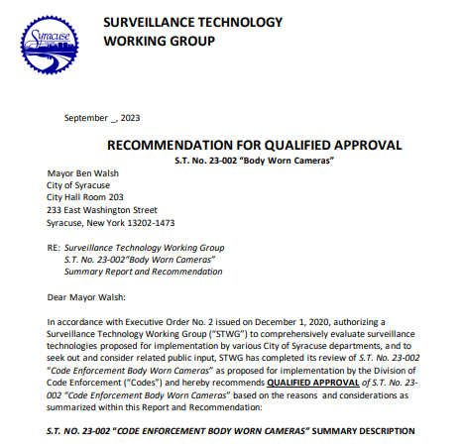
Body Worn Camera – Mayoral Guidelines
  Guidelines were developed
  Was sent to the Mayor in September
  Received signed form back, being put on website

Slide 22
Destiny USA ALPR's

Slide 23
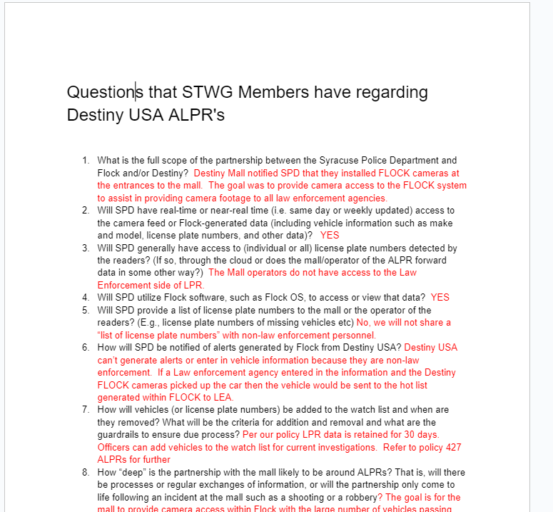
Destiny ALPR's
Questions have been placed into a Google Document HERE

Slide 24
Coming Up
Automated speed & Redlight enforcement technologies
    Gather information
  Work with Comms to make press release
  Group okay with cancelling Tuesday December 26th's Surv. Tech meeting?

Slide 25
Questions
?

Slide 26
Vacant Lot Monitoring (DPW)
Applicant name: DPW Company: Cimcom (Purchased by Quantela) Sponsoring Department: DPW | Application Date: 6/08/2021 Partner Organization/Technologies: Cimcom (Purchased by Quantela) | Proof of Concept Demonstration? Technology Implementation? Exempt?
Technology Purpose: Sensor that detect changes in a scene to monitor lots for dumping. It uses a camera mounted on a street light or utility pole to monitor City-owned vacant lots where illegal dumping is a recurring problem. |  | Operation/Implementation description: The images are edge-processed at the pole utilizing a street light mounted processing device. The edge processor compares current and former images to determine if objects have been left behind. When it detects a dumping event, it sends a text message notification to designated DPW staff. It could potentially be used to obtain images of the illegal dumping events as well.
Data Management Plan: TBD Cloud vs on prem: TBD | Intended Operation: This technology helps DPW to more efficiently pick up trash. | Maintainability/Scalability/Reliability/Vulnerabilities: Unknown Cybersecurity Plan: Unknown Broader Impacts/Unintended Consequences/Concerns: Unknown | Who is the audience for this system?: DPW may decide to share data with Syracuse Police if the images appear to capture a criminal act. How many units/how is the system deployed?: TBD Volume, size and type of data: Images, size TBD Length of time application is expected to be used: Indefinitely
X
  *Full form responses can be viewed HERE

Slide 27
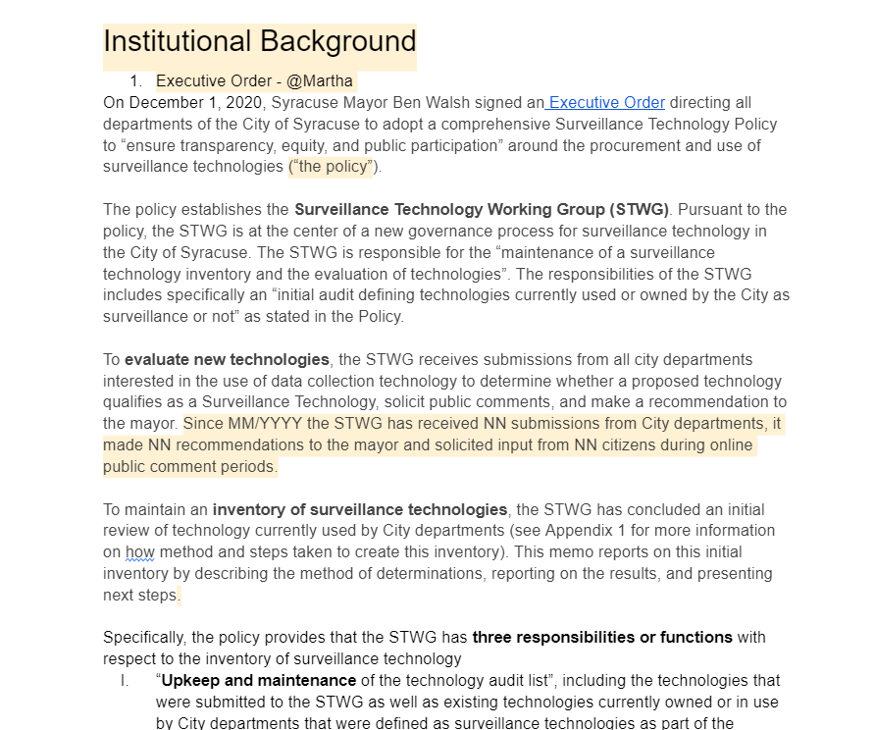
City Wide Technology Audit
The template that we put together so far can be viewed here:
Review updates on different sections

